Slide 1

From Food Waste to Fuel Cell 食物渣工程
ST. PAUL’S CO-EDUCATIONAL COLLEGE, HK
5A Choi Wai Tak
5A Lo Ho Wen
5A Pang Wai Ching Eunice
5B Li Lok Hin
5F Wong Tin Wan

Slide 2
Content
Background information
Objective
Significance
Experiment: Preparation of ethanol (3 steps)
Interpretation of results
Ethanol fuel cell + cyclic voltammetry
Benefits of using food waste
Limitations

Slide 3
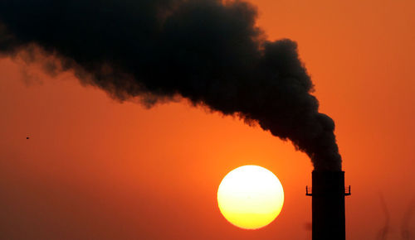
1. Background information
Hong Kong has a high carbon emission per capita (5.5 metric tonnes)

Slide 4
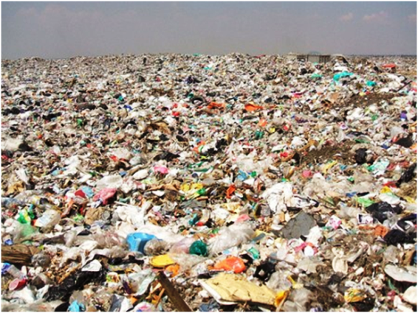
1. Background information
landfills in Hong Kong will be depleted very soon

Slide 5

1. Background information
ok so… what should we do?

Slide 6
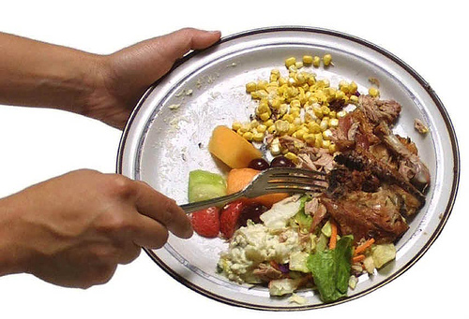
2. Objective
Make use of food waste to produce ethanol which powers fuel cells
Fuel cell

Slide 7

3. Significance
reduce carbon emission + save landfills!!

Slide 8
4. Experiment

Slide 9
What are the procedures for the preparation of ethanol?

Slide 10

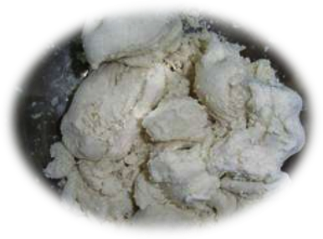
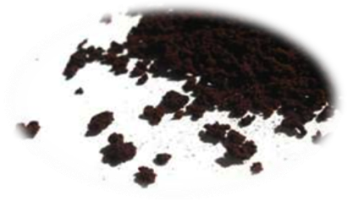
Step 1: Gathering food waste
Considerations when selecting food waste samples:
Abundance
Availability
Ethical issue (why not corn?)
Bread crust
Tofu dregs
Coffee grounds

Slide 11
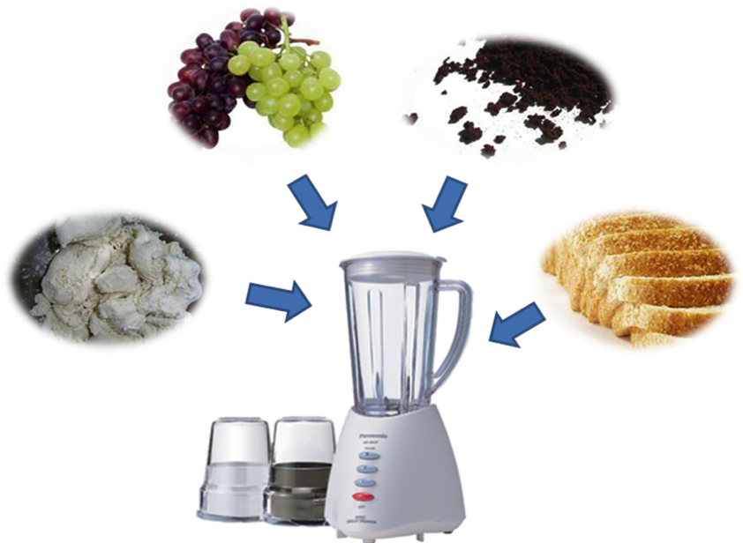
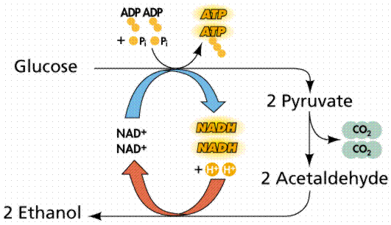
Step 2: Fermentation of food waste extract
Anaerobic fermentation pathway
Add yeast

Slide 12
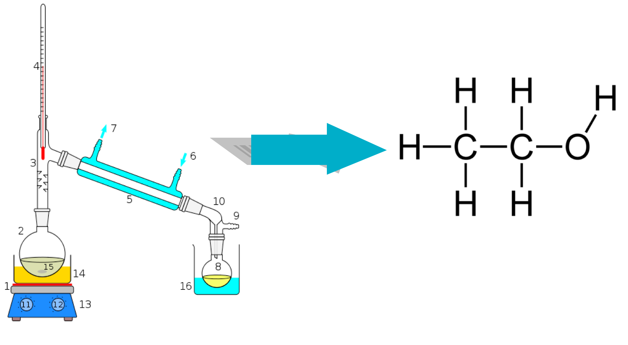
Step 3: Distillation of fermented extract

Slide 13
5. Interpretation of results
A.) Comparing the amount of ethanol obtained from
different kinds of food waste

Slide 14
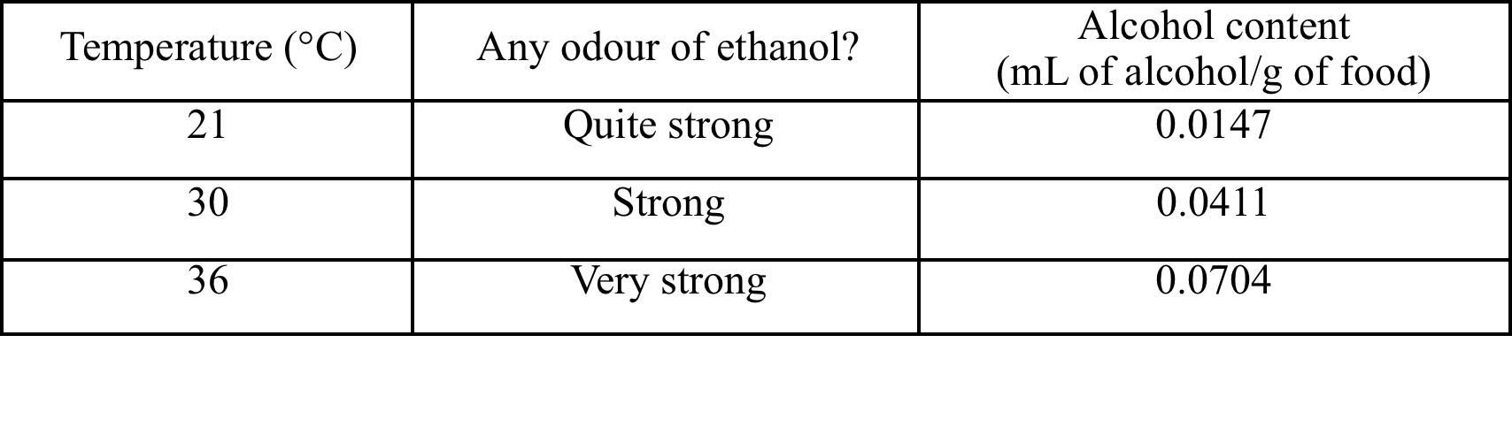
B.) Comparing the efficiency of fermentation at
different temperatures

Slide 15
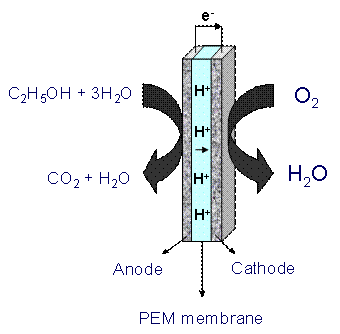
6. Ethanol fuel cell

Slide 16
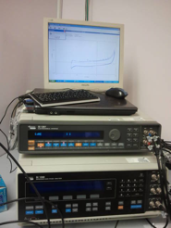
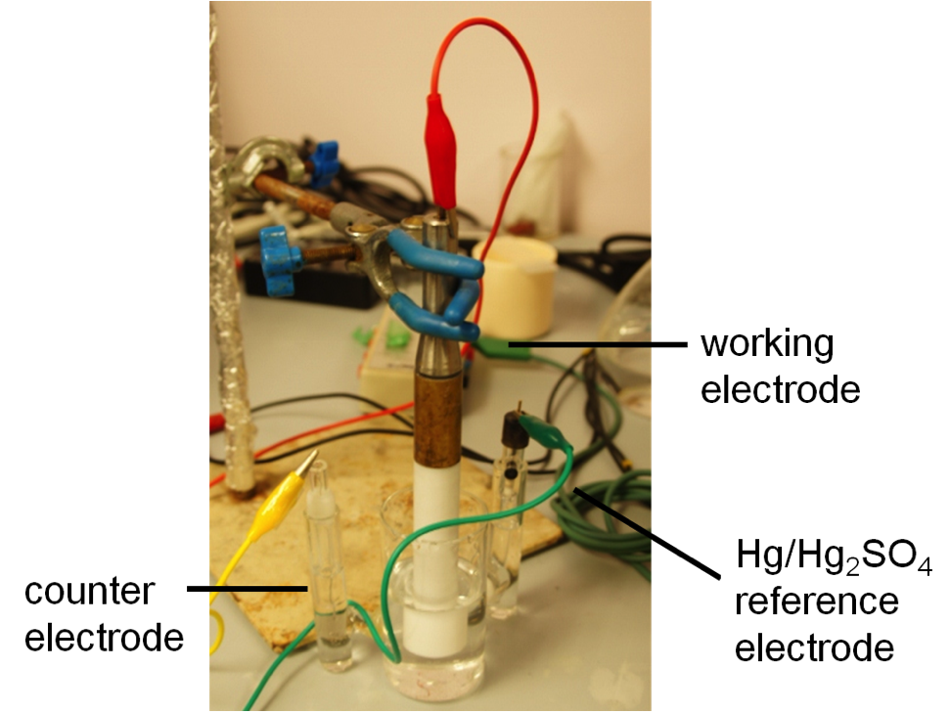
Cyclic Voltammetry

Slide 17
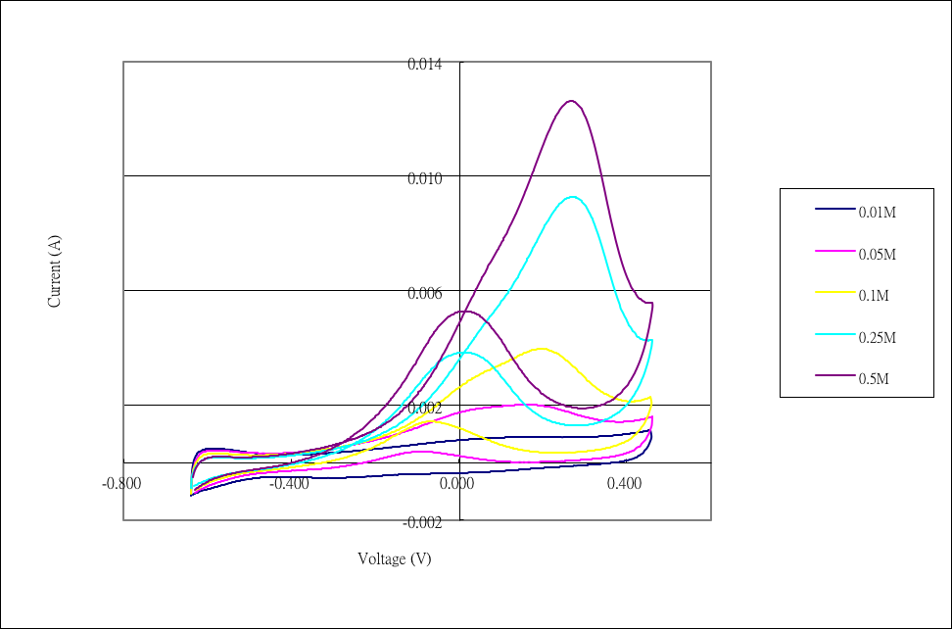

Slide 18
7. Benefits of using food waste to obtain ethanol
Converting waste into useful materials
Alleviating the landfill problems in Hong Kong
Ethanol is a clean fuel
Avoid problems in current bioethanol generation methods

Slide 19
8. Limitations
Limited variety of food wastes
Scale of research

Slide 20
THANK YOU
Acknowledge to
St. Paul’s Co-Educational College
The University of Hong Kong

