Slide 1

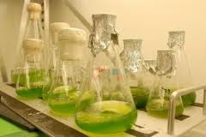
Investigating the factors which influence the carbon fixation of Chlorella pyrenoidosa
and the further use
Tianjin Nankai Highschool
2012
Notes:
（员）Mr. ××, friends from schools around the world, ladies and gentlemen:
We are from Tianjin Nankai High School, and we are overwhelmed by the warm welcome of St. Paul's Co-educational College and the intelligence of other groups. Now, please let us introduce our experiences.

Slide 2

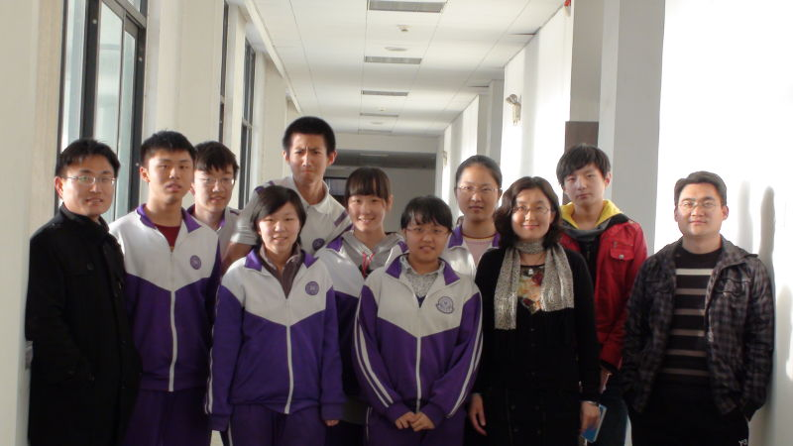
Here We are
Notes:
This is our group in a lab of Tianjin Normal University. From March to June, we prepared our project there.

Slide 3

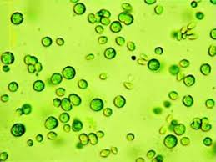
Part 1
Introduction
Notes:
First of all, the outline of our project

Slide 4

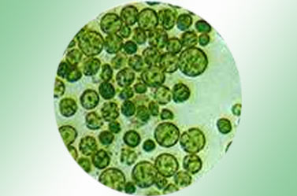
outline
Chlorella
Notes:
this is our topic, Chlorella, which is a kind of algae with diameter of about 5 μm (micrometer). It can capture more CO₂ than other green plants.

Slide 5
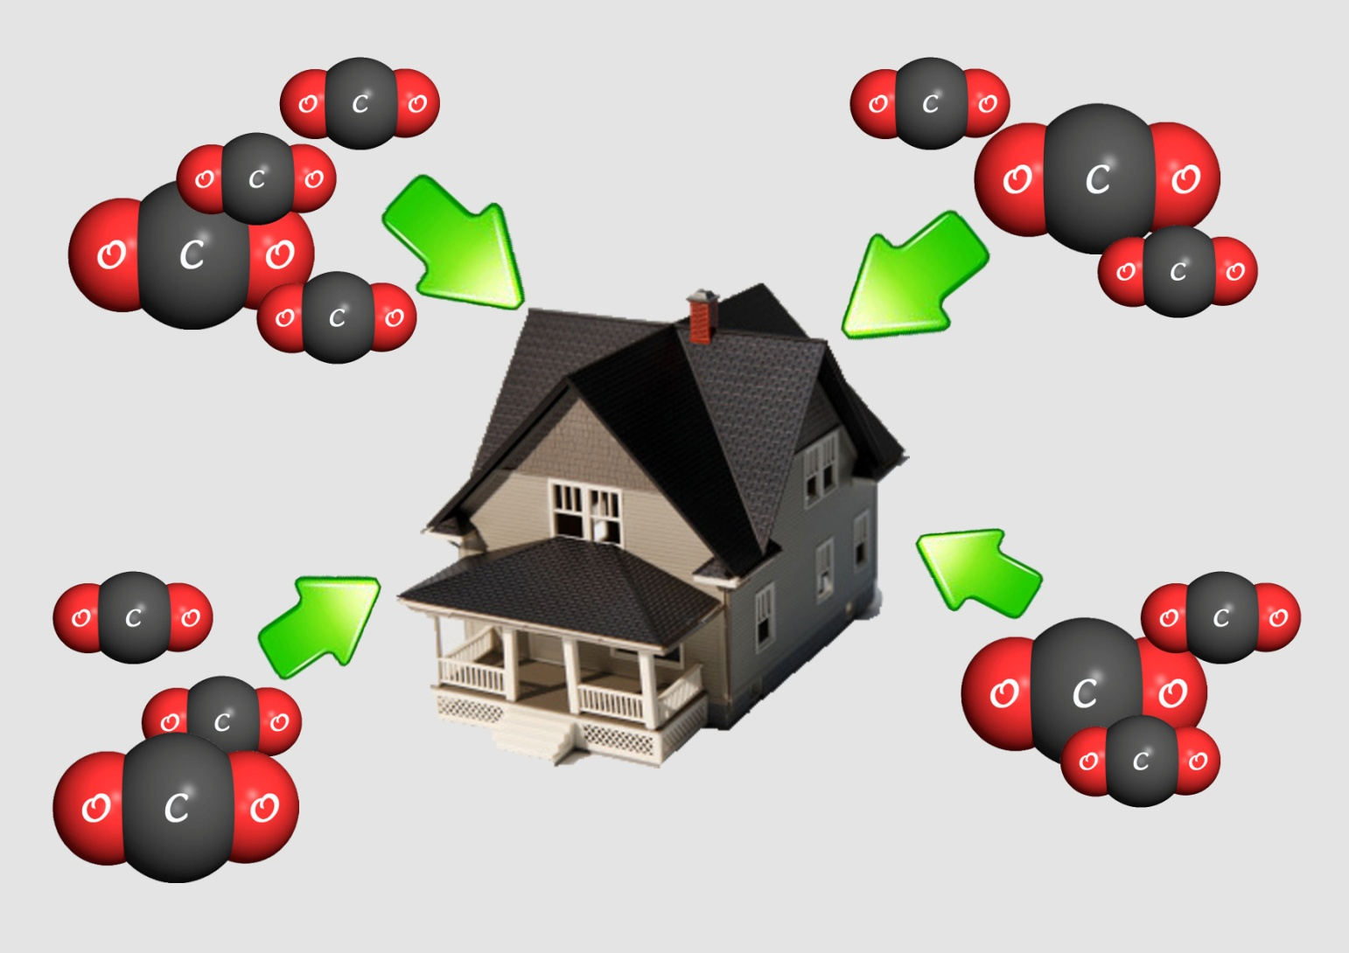
outline
Notes:
We designed an experiment focusing on three factors, purposing to find out the best condition for Chlorella to fix CO₂. The experiment lasted for one week. Then we analyzed the data and drew some conclusions, which were helpful for the domestic carbon fixing equipment.

Slide 6

Part 2
Variables & Methods
Notes:
delete

Slide 7
Hypothesis
temperature
indoor temperature
illuminance
sunny day
flow rate
comparatively strong air flow rate
Notes:
（泽）The hypothesis is as follows: The effect of carbon fixation of Chlorella is related to temperature, illuminance and air flow rate. The best condition for Chlorella, is as shown in the screen.

Slide 8
Variables and Groups
temperature
27℃
35℃
illuminance
37,500lux
18,750lux
air flow rate
7,200 mL/min
3,600mL/min
zero rate
Notes:
How we arrange the variables. We set two levels of temperature; two levels of illuminance; three levels of air flow rate.

Slide 9
Conditions:
2×2×3=12
Total samples:
12×2=24
Notes:
So we have 12 different conditions. And we arrange two glass jars in each condition as repetitive groups. Therefore, there are 24 jars in total.

Slide 10
Experimental Method
Control
Variety
Method
Notes:
And then, the methods we use. We use Control Variety Method to observe the growing condition of Chlorella.

Slide 11
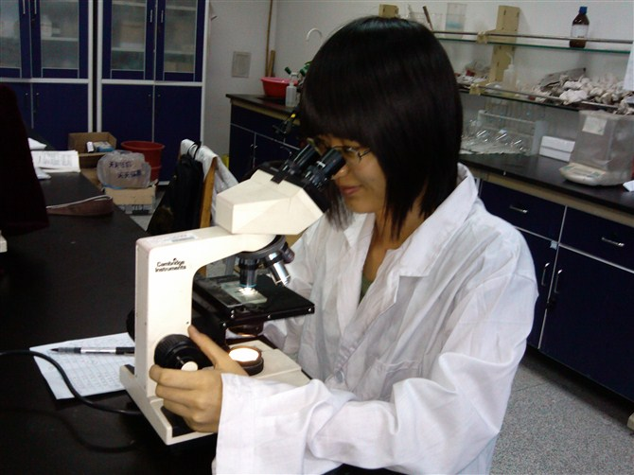
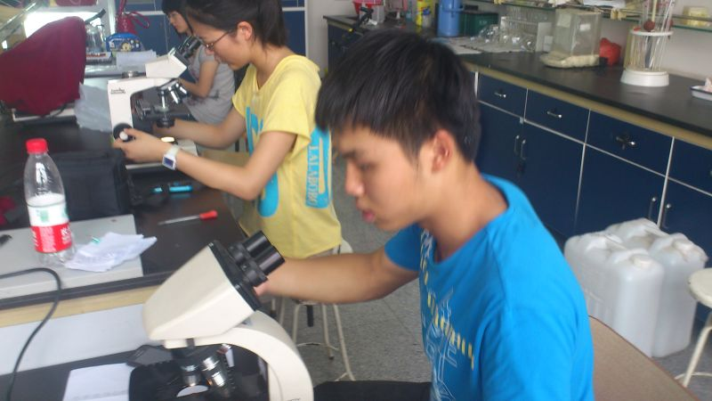
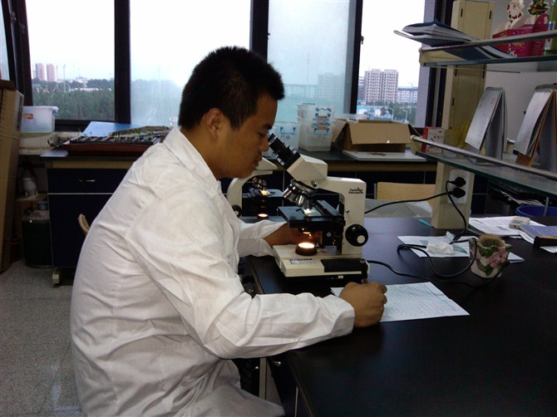
Experimental Method
8 days
Notes:
We count the Chlorella numbers in each jar for eight days,

Slide 12
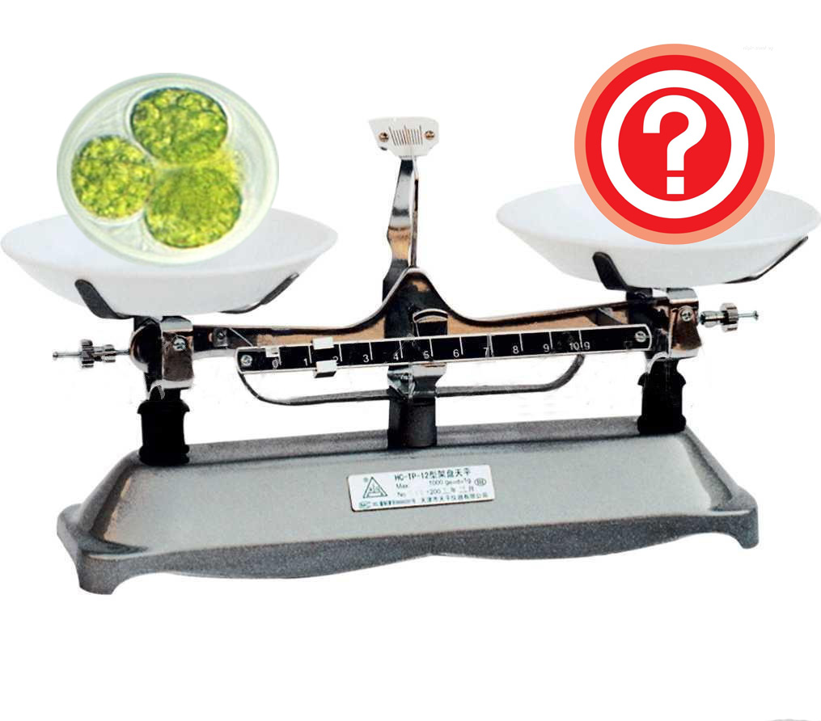
independent experiment
the
mass
of
a single
Chlorella
cell
Notes:
and do an independent experiment aiming to get the mass of a single Chlorella cell,

Slide 13

Experimental Method
m（C）=?
Notes:
then use the “average carbon content” to calculate the mass of carbon.

Slide 14
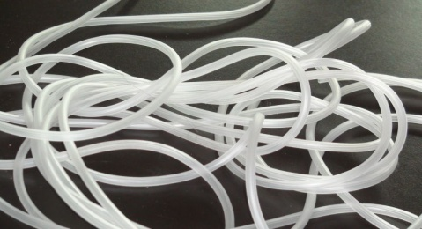
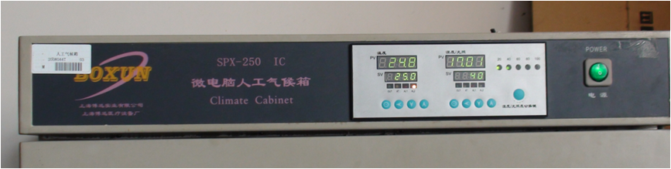
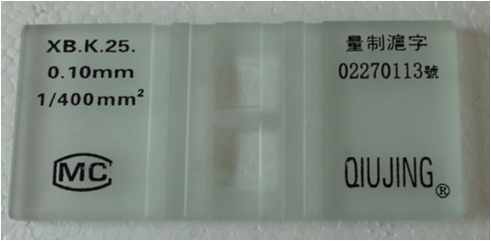
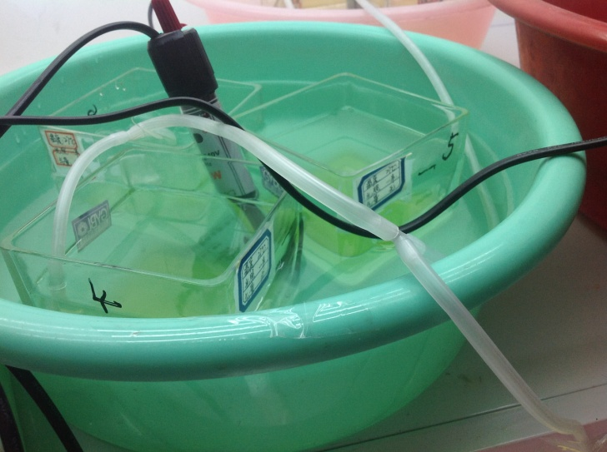
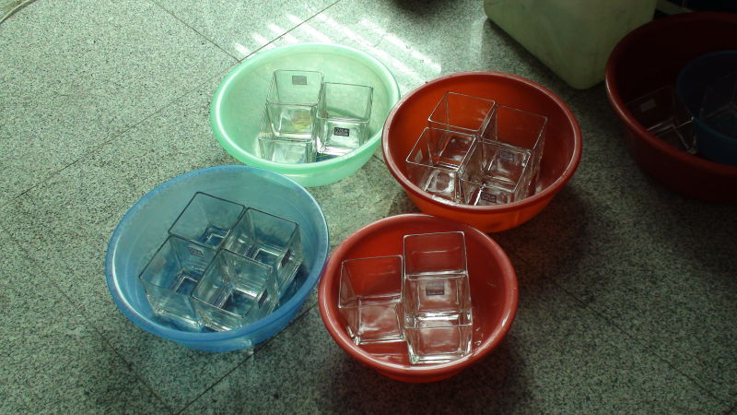
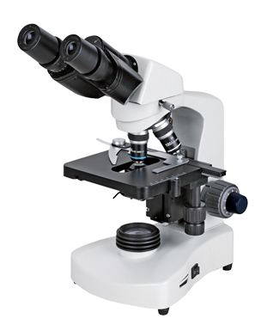
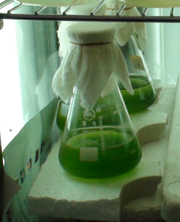
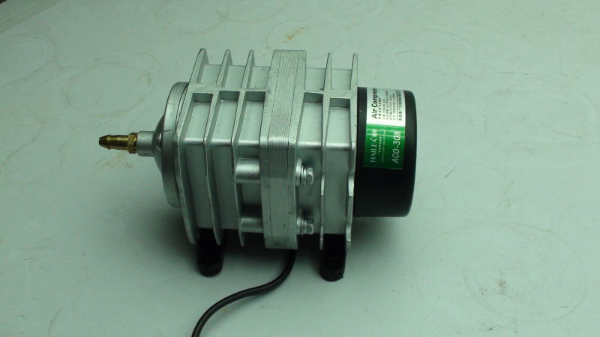
Apparatus
Notes:
These are the apparatus we use. [slide]

Slide 15


Part 3
Procedure
Pre-culture of Chlorella
Install & inject
Count Number
Calculate & convert data
Notes:
（顾）Then let me introduce the experiment process.

Slide 16
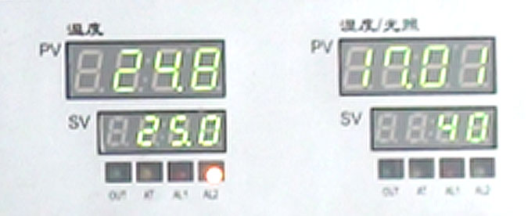
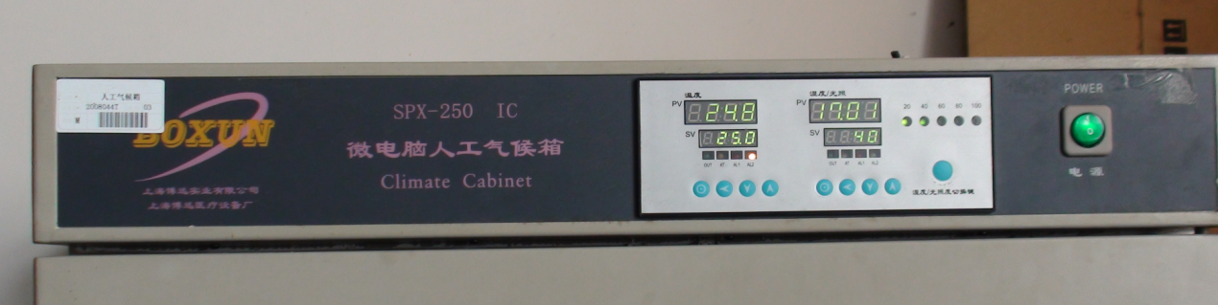
Step 1: Pre-culture
climate cabinet
Chlorella
Notes:
The first step, pre-culture. We put our Chlorella into the climate cabinet and set the conditions as shown in the screen. [pictures] The pre-culture lasted for months.

Slide 17
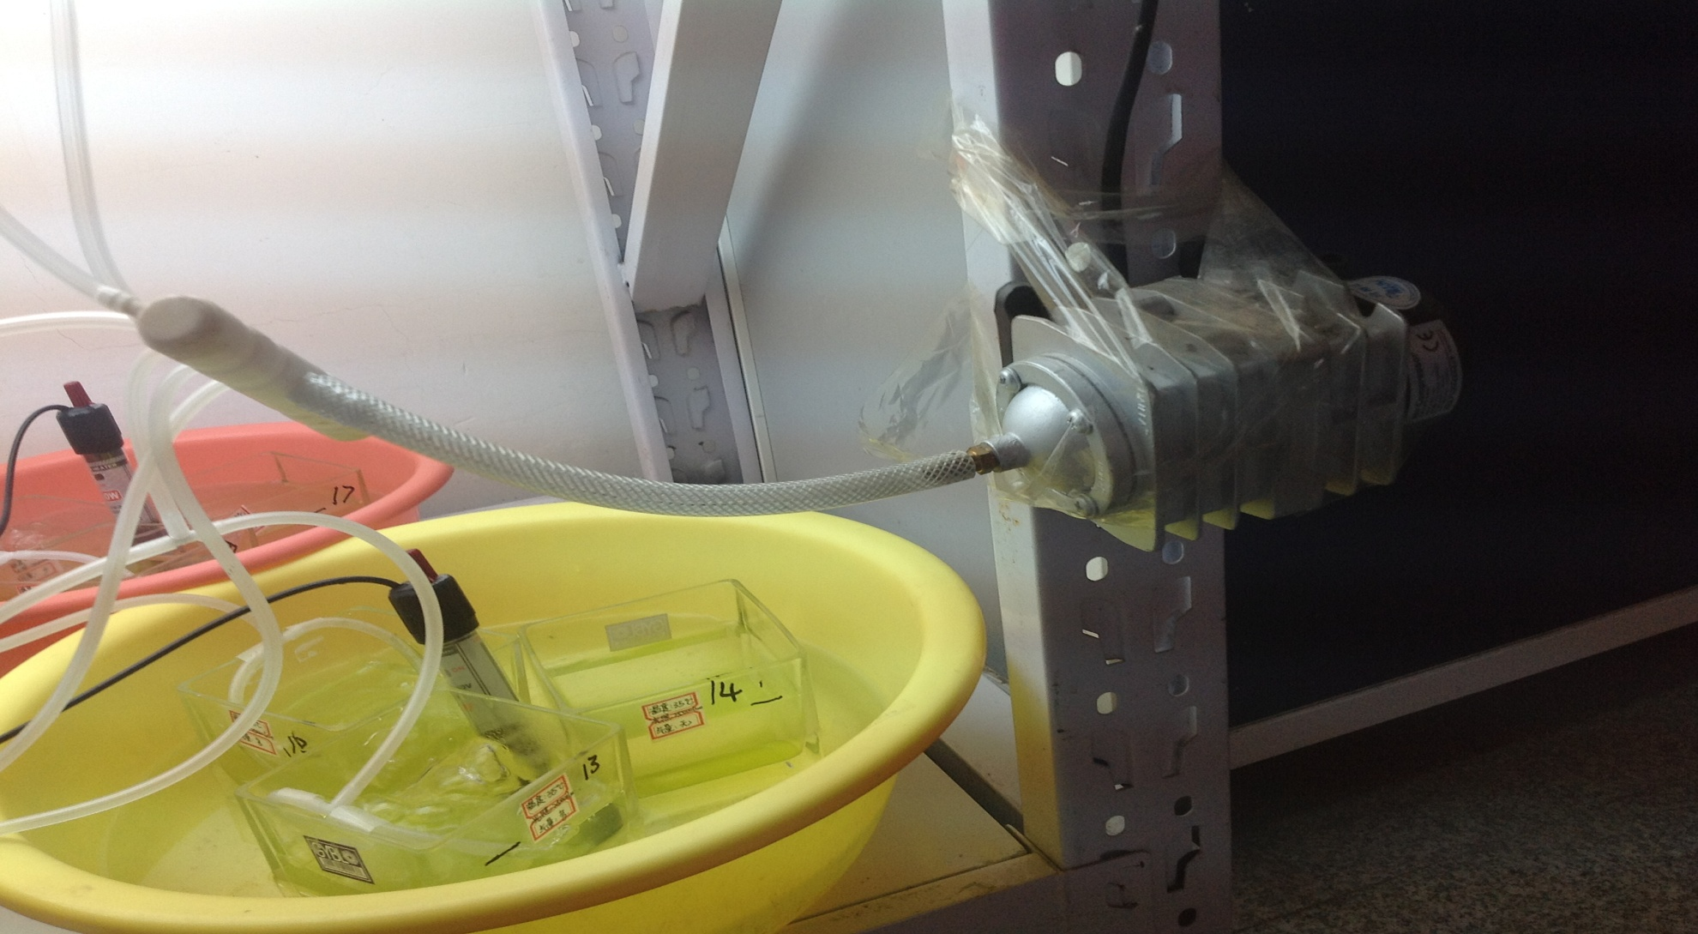
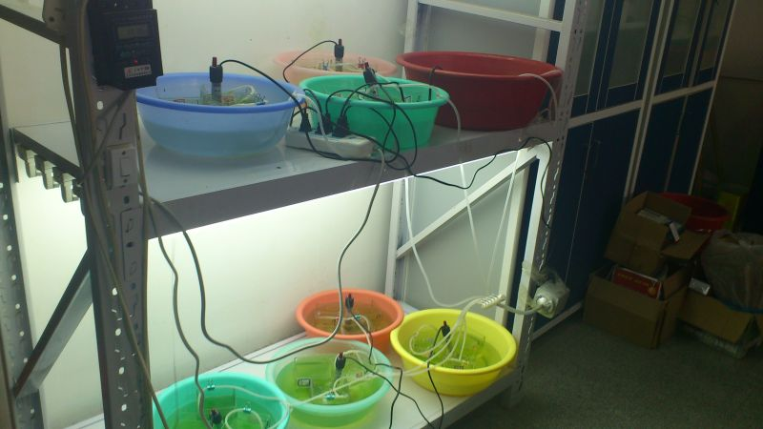
Step2: Beginning
Final effect
Notes:
The second step, beginning. The experiment started at 18:00 on June 2nd. [picture of the whole shelf]

Slide 18

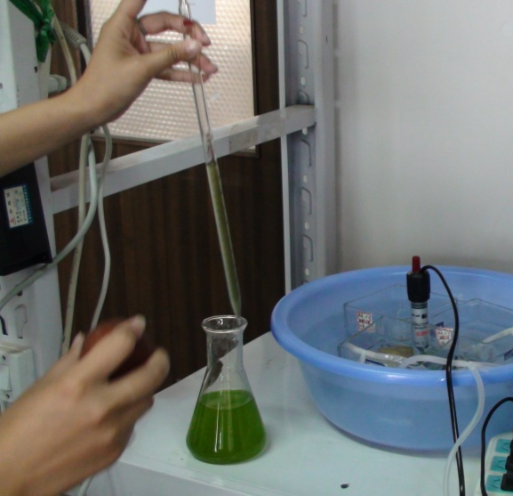
Step2: Beginning
Notes:
We connected the apparatus and poured Chlorella into the 24 jars.

Slide 19
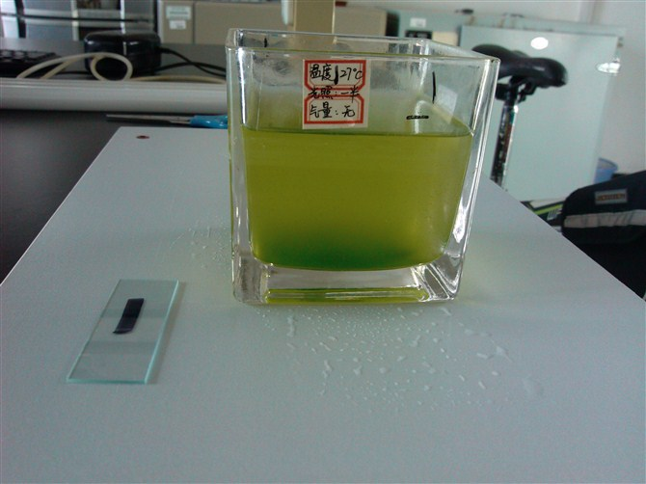
500ml
Notes:
Each jar contains 500mL. [picture]

Slide 20
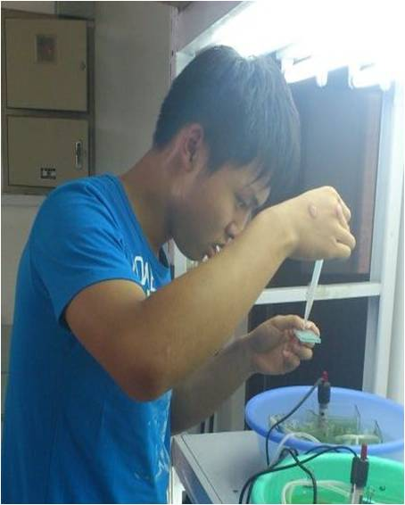
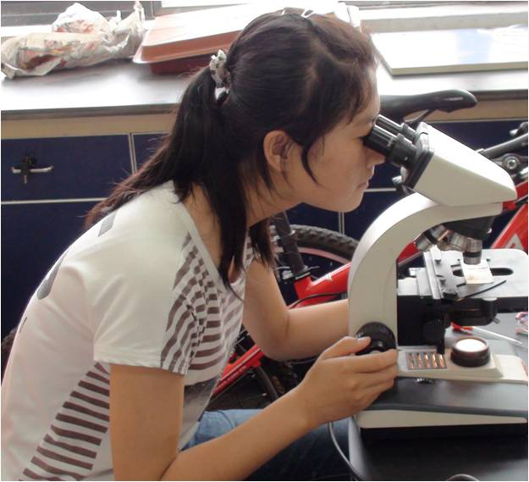
Step 3: number counting
Sampling
Counting
Notes:
The third step, counting and other operations.

Slide 21
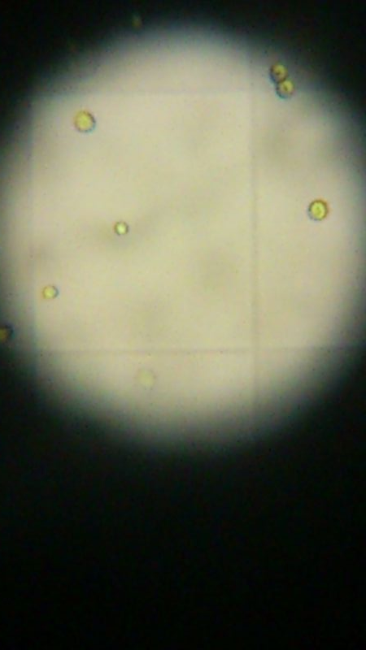
Step 3: number counting
picture of Chlorella in the microscope
Notes:
. From June 3rd, we observed Chlorella for eight consecutive days.

Slide 22
Step 3: number counting
Counting chamber
Microscope
Notes:
We used counting chamber and microscope to count the numbers.

Slide 23
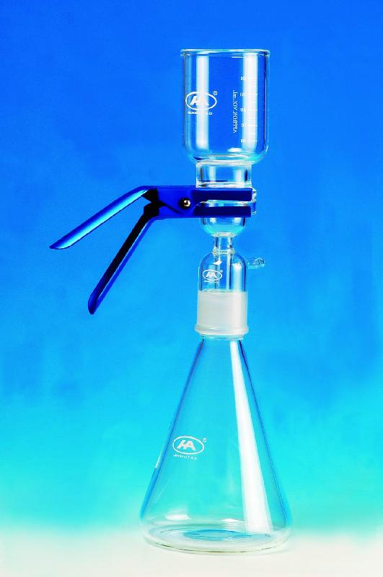
Get the dry weight of Chlorellas
Suction Filtration
Notes:
Another thing we did was suction filtration, which helped us get the dry weight of Chlorellas. Then the dry weight was divided by the numbers with the help of counting chamber. In this way, we got the mass of a single cell.

Slide 24
Step4:calculation
@ If: a cells in counting chamber, then: 5a×10⁶ cells in one jar.
@ mass of Chlorellas in one jar = mass of one single cell × number
@ m(C) = mass of Chlorellas in one jar × 0.59[quoted]
@ m(CO₂) = m(C) × 44/12
Notes:
The fourth step, calculation. We used math formulae to change the original data into the values we wanted, which will be mentioned later.

Slide 25


Part 4
DATA & Calculation
Notes:
The next part, data and conclusions

Slide 26
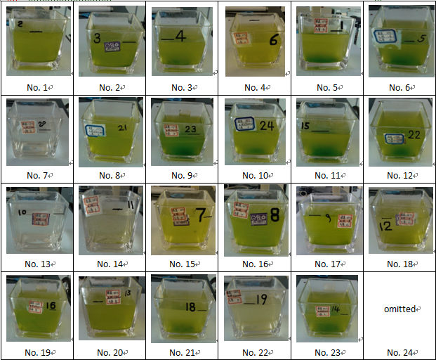
Notes:
Part4
Data

Slide 27
Consequence Number | Temperature (℃) | Illuminance (lux) | Air Flow Rate (mL/min) | Day 1 | Day 2 | Day 3 | Day 4 | Day 5 | Day 6 | Day 7 | Day 8
1 | 27 | 18750 | 7200 | 9 | 21 | 154 | 323 | 361 | 315 | 486 | 426
2 | 27 | 18750 | 7200 | 12 | 24 | 140 | 570 | 175 | 368 | 770 | 426
3 | 27 | 18750 | 3600 | 2 | 14 | 123 | 300 | 95 | 617 | 443 | 743
4 | 27 | 18750 | 3600 | 7 | 28 | 159 | 126 | 281 | 319 | 482 | 549
5 | 27 | 18750 | 0 | 7 | 22 | 147 | 265 | 188 | 461 | 1020 | 762
6 | 27 | 18750 | 0 | 16 | 37 | 189 | 322 | 317 | 428 | 928 | 784
7 | 27 | 37500 | 7200 | 16 | 46 | 111 | 279 | 163 | 111 | 60 | 37
8 | 27 | 37500 | 7200 | 11 | 37 | 186 | 422 | 151 | 503 | 785 | 285
9 | 27 | 37500 | 3600 | 7 | 39 | 114 | 281 | 319 | 357 | 1415 | 1409
10 | 27 | 37500 | 3600 | 14 | 23 | 125 | 213 | 226 | 1343 | 1319 | 255
11 | 27 | 37500 | 0 | 4 | 15 | 154 | 638 | 351 | 2121 | 5623 | 7040
12 | 27 | 37500 | 0 | 15 | 59 | 178 | 549 | 377 | 683 | 2747 | 1113
13 | 35 | 18750 | 7200 | 9 | 20 | 160 | 117 | 309 | 60 | 82 | 456
14 | 35 | 18750 | 7200 | 4 | 12 | 133 | 793 | 245 | 74 | 100 | 612
15 | 35 | 18750 | 3600 | 6 | 53 | 199 | 523 | 414 | 544 | 622 | 371
16 | 35 | 18750 | 3600 | 11 | 47 | 184 | 305 | 343 | 743 | 1535 | 1298
17 | 35 | 18750 | 0 | 5 | 18 | 166 | 432 | 349 | 315 | 580 | 652
18 | 35 | 18750 | 0 | 5 | 27 | 146 | 619 | 316 | 442 | 502 | 1065
19 | 35 | 37500 | 7200 | 2 | 18 | 154 | 577 | 463 | 696 | 536 | 530
20 | 35 | 37500 | 7200 | 6 | 14 | 134 | 595 | 402 | 410 | 485 | 1065
21 | 35 | 37500 | 3600 | 8 | 19 | 101 | 198 | 393 | 272 | 912 | 341
22 | 35 | 37500 | 3600 | 7 | 21 | 149 | 530 | 537 | 662 | 592 | 165
23 | 35 | 37500 | 0 | 4 | 45 | 171 | 371 | 619 | 783 | 969 | 1178
24 | 35 | 37500 | 0 | 7 | 26 | 137 | 451 | 808 | 572 | 1943 | 1394
Notes:
Part4
Data

Slide 28
Notes:
Part4
Data

Slide 29
The influence of temperature
Temperature(℃) | Day 1 | Day 2 | Day 3 | Day 4 | Day 5 | Day 6 | Day 7 | Day 8
27 | 10.0 | 30.4 | 148.3 | 357.3 | 250.3 | 635.5 | 1339.8 | 1152.4
35 | 6.2 | 26.7 | 152.8 | 459.3 | 433.2 | 464.4 | 738.2 | 760.6
Notes:
So, from the first graph, temperature, we can draw these conclusions: During the first 5 days, the two growth lines are almost the same. Since the 6th day, 27℃ is better than 35℃.

Slide 30
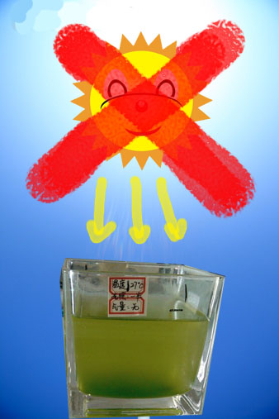
avoid
the
scorching
sunlight
Notes:
Therefore, the environment temperature around our equipment cannot be too high. For example, we should avoid the scorching sunlight in summer. Chlorella can grow well in normal indoor temperature.

Slide 31
The influence of illuminance
Illuminance (lux) | Day 1 | Day 2 | Day 3 | Day 4 | Day 5 | Day 6 | Day 7 | Day 8
18750 | 7.8 | 26.9 | 158.3 | 391.3 | 282.8 | 390.5 | 629.2 | 678.7
37500 | 8.4 | 30.2 | 142.8 | 425.3 | 400.8 | 709.4 | 1448.8 | 1234.3
Notes:
From the second graph, illuminance, we can see that for the whole scale, the two growth lines are almost the same during the first 4 days. Since the 5th day, the growth of Chlorella under 37,500lux is better than that under 18,750lux.

Slide 32
The influence of flow rate
Air Flow Rate (mL/min) | Day 1 | Day 2 | Day 3 | Day 4 | Day 5 | Day 6 | Day 7 | Day 8
7200 | 8.6 | 24.0 | 146.5 | 459.5 | 283.6 | 317.1 | 413.0 | 479.6
3600 | 7.8 | 30.5 | 144.3 | 309.5 | 326.0 | 607.1 | 915.0 | 641.4
0 | 7.9 | 31.1 | 161.0 | 455.9 | 415.6 | 725.6 | 1789.0 | 1748.5
Notes:
So, to summarize, the best condition for Chlorella in our experiment is 27℃ in temperature, 37,500lux in illuminance, and no inputting air.

Slide 33
Best Condition
temperature
27℃ in temperature
illuminance
37,500lux
Flow rate
no artificial inputting air
Notes:
So, to summarize, the best condition for Chlorella in our experiment is 27℃ in temperature, 37,500lux in illuminance, and no inputting air.

Slide 34
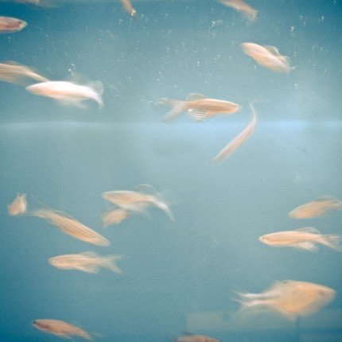


CO₂ Fixation in all
According to the data on the 8th day,
the total amount of carbon fixed by 24 jars of Chlorella in 8 days is 1.5576g, ie.
5.7111g CO₂.
5.7111g CO₂
Notes:
Besides, we can get the carbon fixation amount. According to the data of the last day, our Chlorella captured 1.5g (grammes) carbon in total, which is 5.7g CO₂.

Slide 35
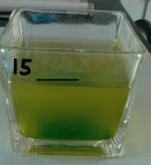
CO₂ Fixation under best condition
2) If we use the data of No.11, which grows the best among the 24 jars, we can get the most CO₂ fixation rate, in our experiment, as 0.4379 g/L·Day.
0.4379 g/L·Day
Notes:
Second, the best carbon dioxide fixation rate is 0.4g/L·D (point four gram per liter per day).

Slide 36

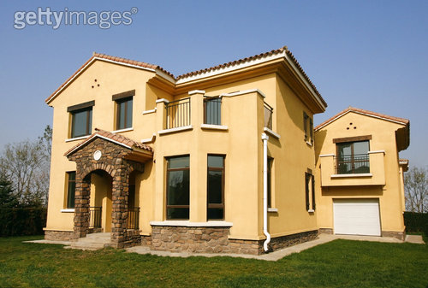
If I have a house of
80 meter squares
Notes:
In other words, if a person has a house of 80 meter square

Slide 37
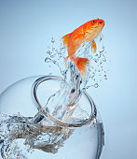
I’ll change my fish
tank into Chlorella
Notes:
and he is willing to change the fish in the fish tank completely into Chlorella

Slide 38

Then the air in my house
can be renewed in 1 week
Notes:
then the air in his house can be renewed in one week.

Slide 39



Part 5
Error
Analysis
Notes:
（申）And then comes the most troublesome but intriguing part, the error analysis. Because we hope to conserve the reality, we show all of the original data to you. But we must discuss why the abnormal data appear.

Slide 40
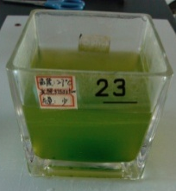
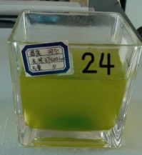
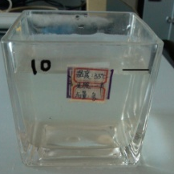
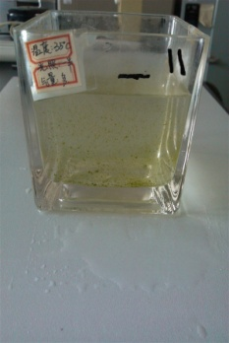
Data cannot match the photos
No.9
1409
No.10
255
8th day’s
number
No.13
456
No.14
612
Notes:
The first part is the data which cannot match the photos.

Slide 41
Analysis
Main reason: Inaccuracy of counting
instrumental error
theoretical error
personal error
Notes:
Well, the main reason is the inaccuracy of counting, which includes three parts.

Slide 42
Instrumental error
Chlorellas get together (sometimes about 100 cells each clot) and there are more than one layer existing
The different sizes of the plastic basins may cause uneven heating
We just use one air compressor and this may cause uneven aeration
Notes:
The instrumental error includes the counting method, the plastic basins, the air compressor and so on.

Slide 43
Theoretical Error
V
E
R
S
U
S
"average carbon content"
real carbon content
Notes:
For theoretical error, the first point, is to add several levels for each factor. The second point is concerning about the difference between the "average carbon content" which we quoted and the real content we used.

Slide 44
Theoretical Error
take samples repeatedly
Notes:
And the third point is to take samples repeatedly.

Slide 45
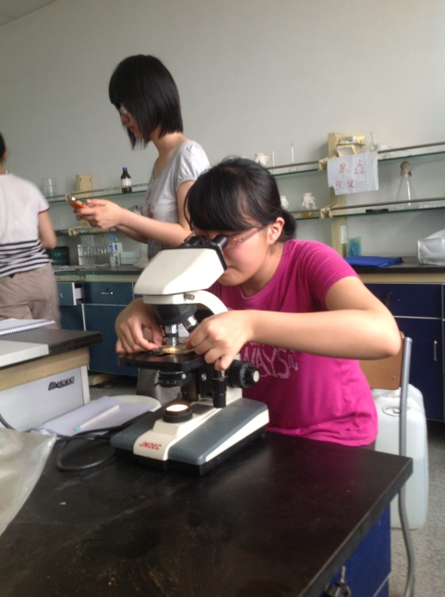
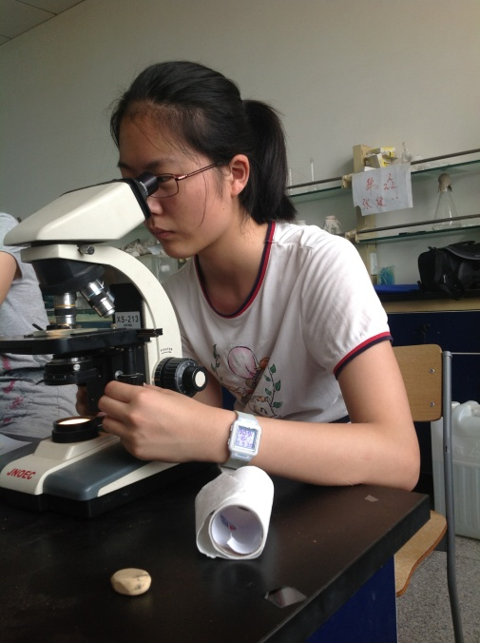
personal error
different habits of
using microscope
Notes:
As personal errors, the different habits of using microscope,

Slide 46


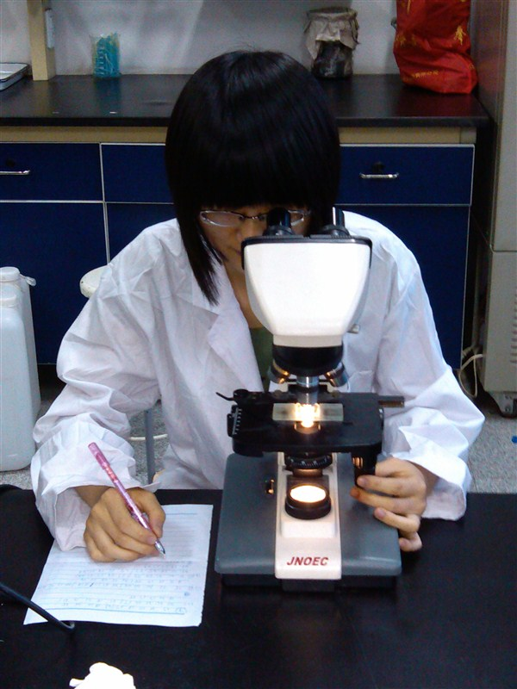
personal error
time difference when taking samples
Notes:
and the time difference when taking samples, may cause the error.

Slide 47

decreasing of Chlorella???
caused by inexact counting process???
the air from rubber tubing would make the Chlorella splash out of the jars???
Chlorella is actually decreasing???
the air flow rate may be so strong that the cells were broken by the flow???
some creatures in the air to prey Chlorella???
Notes:
The second part is the data which show the decreasing of Chlorella. Well, they may caused by inexact counting process, and perhaps the Chlorella is actually decreasing indeed.

Slide 48

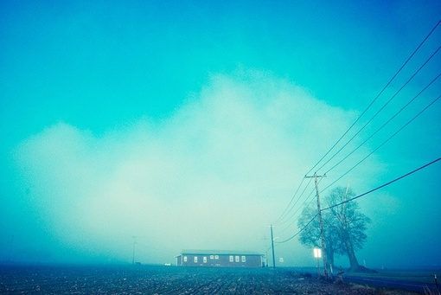
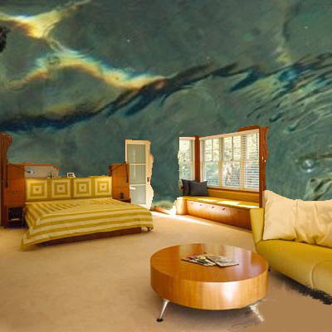
Part 6
Notes:
6

Slide 49

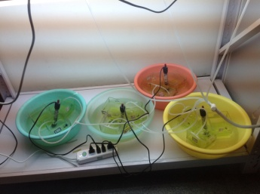
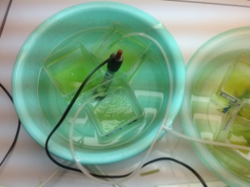
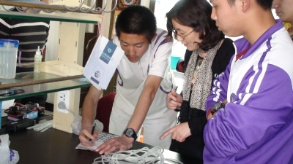
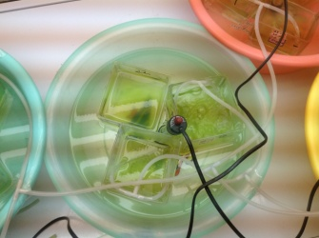


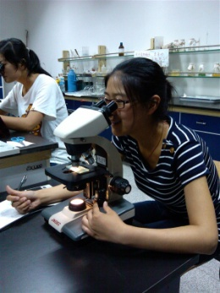
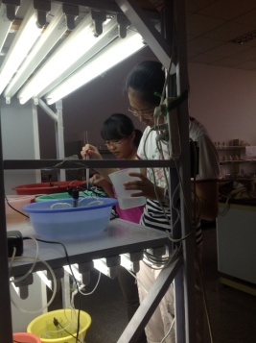
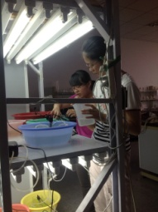


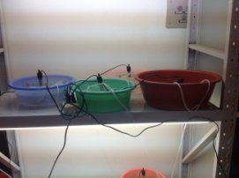


２
Notes:
7

Slide 50

Notes:
7

Slide 51

Notes:
提问

Slide 52

The End

