Slide 1

Investigating the use of steam pretreatment on cellulosic waste for bioethanol production
Team members:
James Ang
Andrew Loh
Woo Yu Xuen

Slide 2
Content
Background
Rationale
Hypothesis
Independent variables
Dependent variables
Objectives
Materials
Methodology
Data Analysis
Conclusion

Slide 3
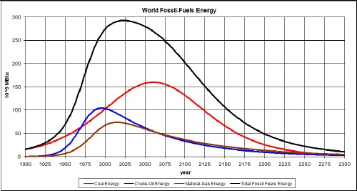
Background
Dwindling fossil fuel resources
Biofuels are a viable alternative
Cellulosic waste is cost efficient
Maximization of bioethanol yield
  Pretreatment of cellulosic waste is necessary
http://www.ecobuddhism.org/files/3512/8403/9398/FossilFuelsEnergy.jpg

Slide 4
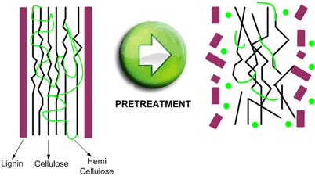
Background - pretreatment
Pretreatment breaks down the lignocellulosic structure to its monosaccharide components
Increases accessibility of cellulose
Enhances rate of hydrolysis
Increased
Yield
http://www.hrs-heatexchangers.com/images/applications/bioethanol/en-thermal-hydrolysis1.gif

Slide 5
Rationale
However, pretreatment accounts for a significant part of total cost
Steam pretreatment at high temperature has proven to be effective, although costly
Essential to develop an affordable yet productive method of steam pretreatment
Lowering temperature requirement of steam pretreatment lowers cost

Slide 6
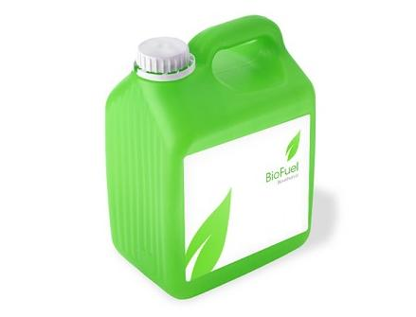
Hypothesis
Steam pretreatment at low intensities would enhance hydrolysis rate and increase ethanol yield
http://www.ecofireplace.co.uk/assets/images/bioethanolfuel.jpg

Slide 7
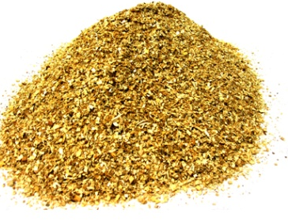
Independent Variables
Method of pretreatment
  Steam pretreatment
  Acid pretreatment
  No pretreatment (control)
Source of biomass
  Sawdust
  Sugarcane
Method of hydrolysis
http://www.alliedkenco.com/catalog/images/SAWDUST.jpg
  Acid
  Enzymatic

Slide 8
Controlled Variables
Amount of biomass, acid, enzymes, per experiment
Fermentation
  Amount of selected microorganism used
Fractional Distillation
Temperature and other conditions within each step

Slide 9
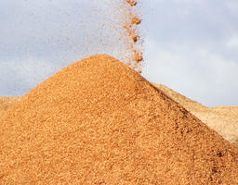
Dependent Variable
Yield of bioethanol (in terms of concentration)
http://www.thedailygreen.com/cm/thedailygreen/images/sawdust-pile-lg.jpg
http://www.ecofireplace.co.uk/assets/images/bioethanolfuel.jpg

Slide 10
Objective
Investigate if steam pretreatment at a low intensity can still increase yield of bioethanol
Investigate the efficiency of steam pretreatment with different hydrolysis methods
Show that cellulosic plant waste is a source of viable renewable energy

Slide 11
Materials
Biomass
Sawdust
Pretreatment
Autoclave
Sulfuric acid
Hydrolysis
Fermentation
Saccharomyces cerevisiae
Distillation
Fractionating Column
Reflux set-up
Cellulase and Beta-Glucosidase
Aqueous ammonia
pH paper
Incubator
DI water
Sodium hydroxide
Sodium carbonate
Sugarcane

Slide 12
Methodology (Brief)
Biomass
Steam pretreatment
OR
Acid pretreatment
Acid hydrolysis
OR
Enzymatic hydrolysis
Fermentation using yeast
Fractional Distillation
Test for ethanol concentration

Slide 13
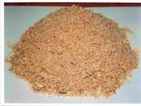
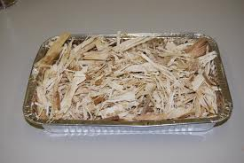
Methods: preparation of biomass
Sawdust
  Sawdust was moistened
Sugarcane
  Sugarcane was
  moistened then blended

Slide 14
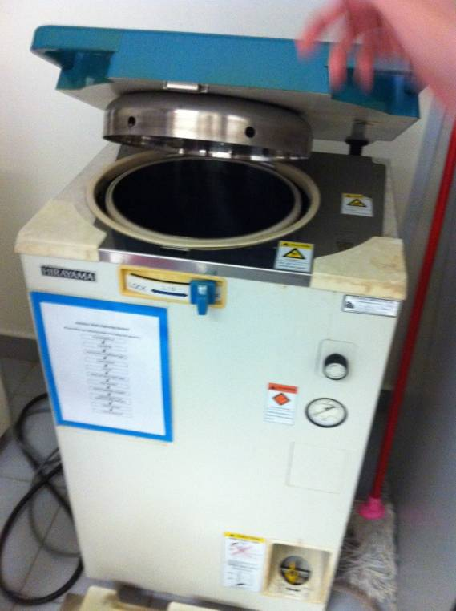
Methods: Steam pretreatment
Steam pretreatment
Feed 30g of moist biomass into autoclave
Temperature set at 105°C for 6mins
Autoclave

Slide 15
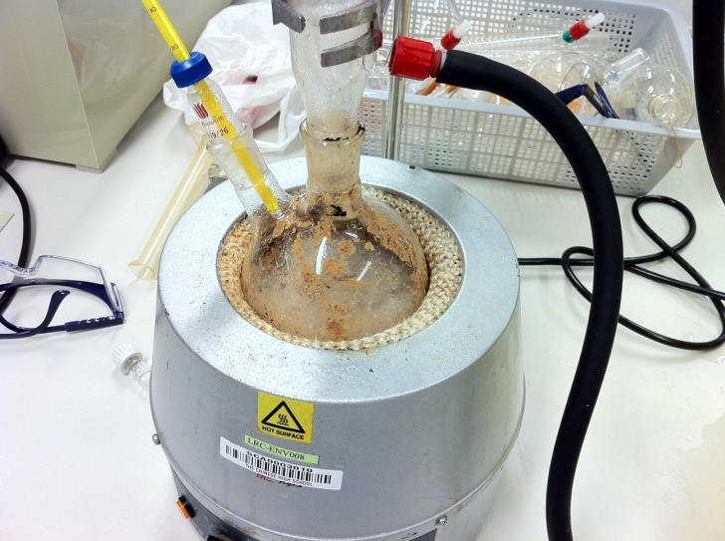
Methods: Acid pretreatment
Acid pretreatment
Add concentration 5% H₂SO₄ (60g) to 30g biomass at 2:1 ratio
Heated at 90°C for 30mins
Reflux set-up
Reflux set-up

Slide 16
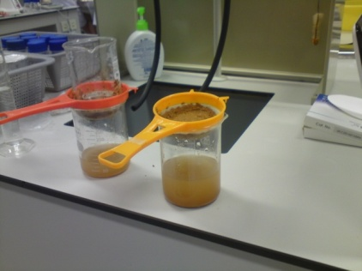
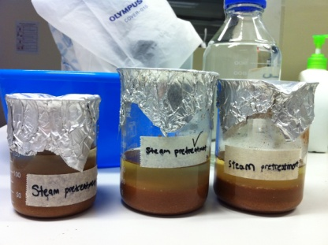
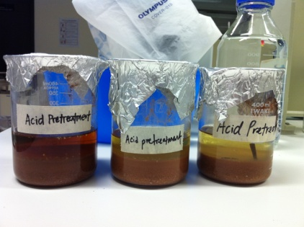
Methods: acid hydrolysis
Add 10% sulfuric acid (60g) to the pretreated biomass in the ratio 2:1
Put sample through reflux set-up for 2 hours at 120°C
Hydrolysed biomass was filtered
  Filtrate was neutralised
Filtration using sieves
Steam pretreated sawdust after acid hydrolysis
Acid pretreated sawdust after acid hydrolysis

Slide 17
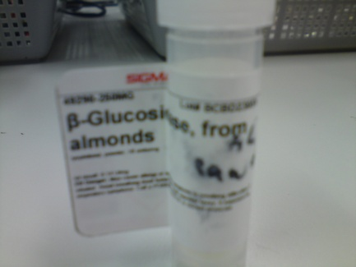
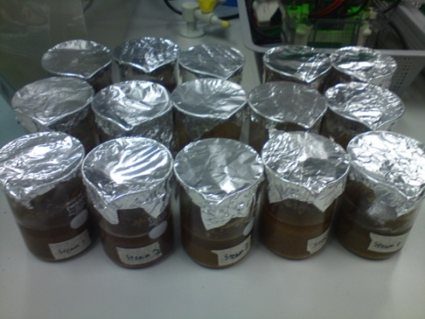
Methods: enzymatic hydrolysis
Acid-pretreated biomass was neutralised with sodium carbonate
Cellulase then Beta-glucosidase
Temperature kept at constant 36°C in an incubator
Duration of 40 hours for each
enzyme
Hydrolysed biomass was filtered
and the filtrate was bottled
Beta-glucosidase
Sawdust samples before enzymatic hydrolysis

Slide 18
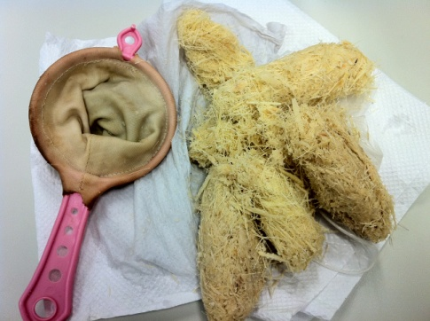
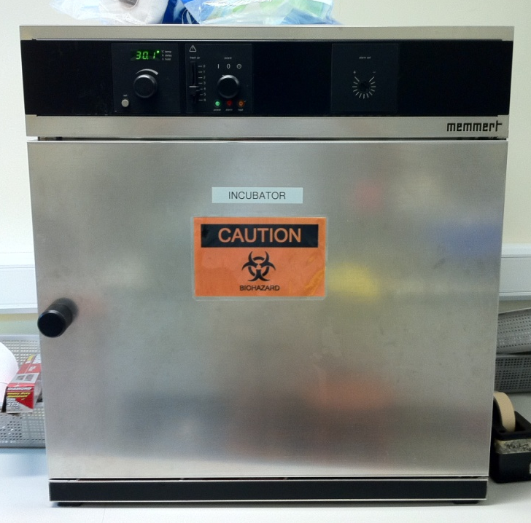
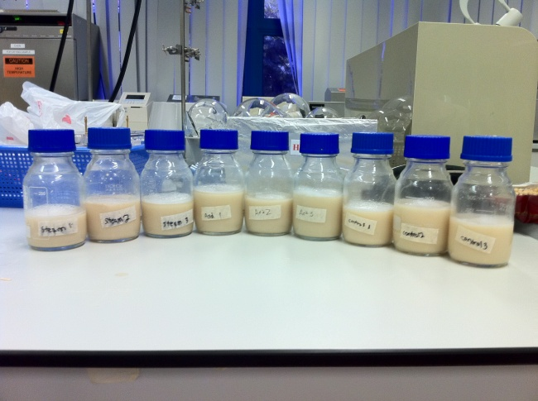
Methods: fermentation
Fermentation using yeast
  Yeast input at 4% of substrate volume
  Conducted at 36 °C in an incubator for 40 hours
Filtration
sugarcane samples after fermentation
Incubator

Slide 19
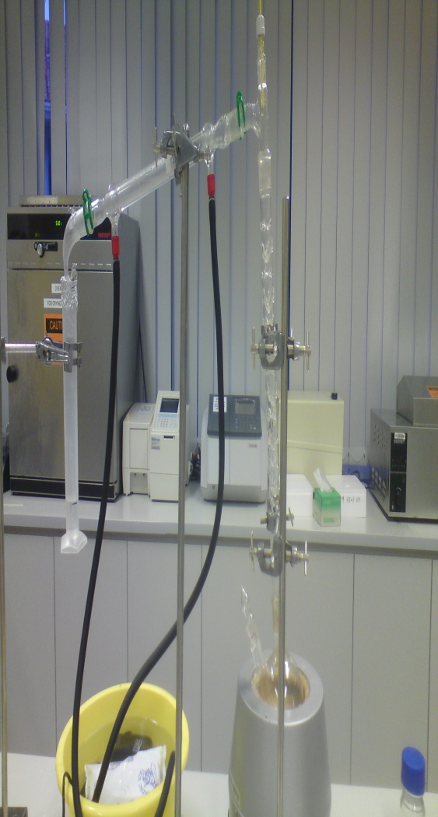
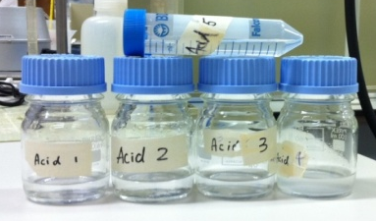
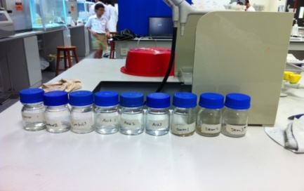
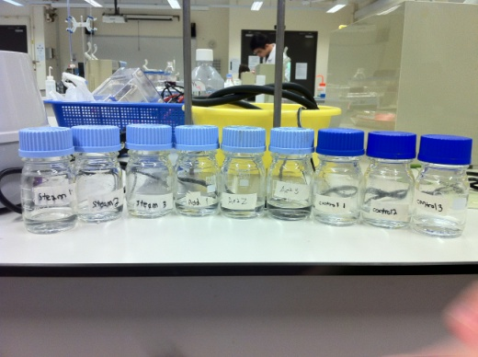
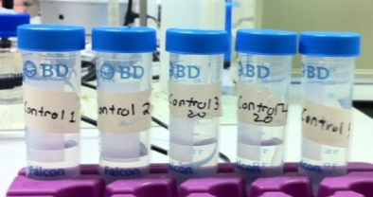
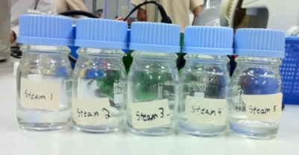
Methods: distillation
Fractional Distillation
  Collect 1/5 of the original
  volume of fermented filtrate
Fractional distillation set-up

Slide 20
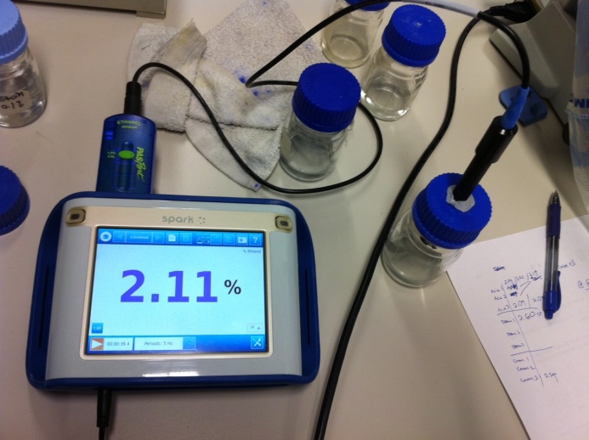
Test for ethanol concentration
Ethanol concentration measured
using ethanol sensor provided by lab
Compare concentration with the different set-ups to establish conclusion
Ethanol sensor

Slide 21
Data Analysis: sawdust (acid)
Results of the various pretreatments + acid hydrolysis on sawdust samples
Measured in ethanol concentration (%)
 | Acid 1 | Acid 2 | Acid 3 | Steam 1 | Steam 2 | Steam 3 | Control 1 | Control 2 | Control 3
Test 1 | 2.09 | 2.12 | 2.09 | 2.6 | 2.56 | 2.49 | 2.39 | 2.47 | 2.54
Test 2 | 2.1 | 2.05 | 2.07 | 2.69 | 2.4 | 2.39 | 2.35 | 2.32 | 2.67
Test 3 | 2.14 | 2.01 | 2.14 | 2.57 | 2.48 | 2.59 | 2.22 | 2.29 | 2.44
Mean | 2.11 | 2.06 | 2.1 | 2.62 | 2.48 | 2.49 | 2.32 | 2.36 | 2.55
Std dev | 0.026457513 |  |  | 0.078102 |  |  | 0.122882

Slide 22
Data Analysis: sawdust (acid)
`

Slide 23
Data Analysis: sawdust (enzymatic)
Results of the various pretreatments and enzymatic hydrolysis on sawdust samples
Measured in ethanol concentration (%)
 | Acid 1 | Acid 2 | Acid 3 | Acid 4 | Acid 5 | Steam 1 | Steam 2 | Steam 3 | Steam 4 | Steam 5 | Control 1 | Control 2 | Control 3 | Control 4 | Control 5
Test 1 | 3.98 | 5.82 | 5.45 | 5.62 | 5.32 | 9.87 | 7.68 | 8 | 7.62 | 8.03 | 3.97 | 4.35 | 6.13 | 4.48 | 4.45
Test 2 | 3.97 | 5.3 | 5.5 | 5.6 | 5.2 | 9.36 | 7.87 | 8.2 | 7.52 | 8.2 | 3.6 | 4.4 | 6.07 | 4.44 | 4.35
Test 3 | 4.11 | 5.5 | 5.37 | 5.73 | 5.44 | 8.79 | 7.97 | 8.31 | 7.6 | 8.16 | 3.86 | 4.51 | 5.95 | 4.4 | 4.43
Mean | 4.02 | 5.54 | 5.44 | 5.65 | 5.32 | 9.34 | 7.84 | 8.17 | 7.58 | 8.13 | 3.81 | 4.42 | 6.05 | 4.44 | 4.41
Std dev | 0.667518 |  |  |  |  | 0.674292 |  |  |  |  | 0.750642

Slide 24
Data Analysis: sawdust (enzymatic)

Slide 25
Data Analysis: sugarcane (enzymatic)
Results of the various pretreatments and enzymatic hydrolysis on sugarcane samples
Measured in ethanol concentration (%)
 | Acid 1 | Acid 2 | Acid 3 | Steam 1 | Steam 2 | Steam 3 | Control 1 | Control 2 | Control 3
Test 1 | 4.76 | 4.28 | 4.60 | 5.92 | 6.10 | 5.82 | 3.94 | 3.58 | 3.00
Test 2 | 4.96 | 4.20 | 4.78 | 5.98 | 6.06 | 5.84 | 3.98 | 3.62 | 3.02
Test 3 | 4.92 | 4.30 | 4.60 | 6.10 | 5.96 | 5.74 | 4.02 | 3.72 | 2.86
Mean | 4.88 | 4.26 | 4.66 | 6.00 | 6.04 | 5.80 | 3.98 | 3.64 | 2.96
Std dev | 0.314325 |  |  | 0.128582 |  |  | 0.424055

Slide 26
Data Analysis: sugarcane (enzymatic)

Slide 27
Conclusion
Steam pretreatment at 105 °C for 6 minutes increases ethanol yield
For enzymatic hydrolysis: steam pretreatment > acid pretreatment > no pretreatment
Acid pretreatment did not significantly increase the yield compared to control set ups
Experiments utilising sugarcane showed to have lower ethanol concentration compared to that of sawdust from enzymatic hydrolysis
Steam pretreatment is the most effective in maximising bioethanol yield for biomass. Sugarcane has lower cellulose content compared to sawdust.
HYPOTHESIS PROVEN

Slide 28
Limitations
Small sample size, unable to achieve the most reliable results
Ethanol sensor is not as accurate for ethanol concentrations above 3% although it still gives us a relative comparison

Slide 29
Application
Fuel for vehicles to reduce reliance on fossil fuels
Reduce carbon footprint
Cheap and viable alternative
Reliable source of energy to meet demands

Slide 30
Bibliography (I)
Google Images
Prusty B.A.K., Chandra R. and Azeez P.A. (2008). Biodiesel: freedom from dependence on fossil fuels? http://precedings.nature.com/documents/2658/version/1/files/npre20082658-1.pdf
Day D.F., DeQueiroz G.A. and Legendre B.L. (2008). Turning sugarcane cellulose into ethanol: energy for the future? http://www.lsuagcenter.com/en/communications/publications/agmag/Archive/2008/Spring/Turning+sugarcane+cellulose+into+ethanol+Energy+for+the+future.htm
Zhiguang Z. (2009). Investigating biomass saccharification for the production of cellulosic ethanol. http://scholar.lib.vt.edu/theses/available/etd-05042009-143825/unrestricted/ZhiguangZhuMSthesis-2.pdf
Jeoh T. (1998). Steam explosion pretreatment of cotton gin waste for fuel ethanol production. http://scholar.lib.vt.edu/theses/available/etd-011499-120138/unrestricted/ETD.PDF
Corredor D.Y. (2008). Pretreatment and enzymatic hydrolysis of lignocellulosic biomass. http://krex.k-state.edu/dspace/bitstream/2097/693/1/DeisyCorredor2008.pdf
Yang B. and Wyman C.E. (2007). Pretreatment: the key to unlocking low-cost cellulosic ethanol. http://www.che.ncsu.edu/ILEET/CHE596web_Spr2010/resources/biomass-biofuels/Pretreatment-The-Key.pdf

Slide 31
Bibliography (II)
Badger, P.C. (2002). Ethanol from cellulose: a general review. p. 17–21 http://www.hort.purdue.edu/newcrop/ncnu02/v5-017.html
Friedemann A. (2007). Peak soil: why cellulosic ethanol and other biofuels are not sustainable and a threat to america's national security - Part I. http://www.energycentral.com/generationstorage/fossilandbiomass/articles/1478/Peak-Soil-Why-Cellulosic-ethanol-and-other-Biofuels-are-Not-Sustainable-and-a-Threat-to-America-s-National-Security-Part-I/
Foody B., Tolan J.S. and Bernstein J.D. (1999) Pretreatment process for conversion of cellulose to fuel ethanol. http://www.google.com.sg/patents?hl=en&lr=&vid=USPAT5916780&id=dwEYAAAAEBAJ&oi=fnd&dq=steps+to+convert+cellulose+to+bioethanol&printsec=abstract#v=onepage&q=pretreatment&f=false
Mosier N., Wyman C.E., Dale B., Elander R., Lee Y.Y., Holtzapple M. and Ladisch M. (2004)
Features of promising technologies for pretreatment of lignocellulosic biomass. http://stl.bee.oregonstate.edu/courses/ethanol/restricted/MosierETAL2005.pdf
Lynd L.R. (1996). Overview and evaluation of fuel ethanol from cellulosic biomass: technology, economics, the environment, and policy. http://www.rw.ttu.edu/2302_phillips/Debatearticles/Sp_2008_debates/E85con.pdf

Slide 32
Bibliography (III)
Muller W., Ferry D., N.Y., Miller F., (1980) Process for the acid hydrolysis of carbohydrate polymers and the continuous of the sugars obtained therefrom to provide ethanol. http://www.docstoc.com/docs/31441670/Process-For-The-Acid-Hydrolysis-Of-Carbohydrate-Polymers-And-The-Continuous-Fermentation-Of-The-Sugars-_obtained-Therefrom-To-Provide-Ethanol---Patent-4242455#viewer-area
Philippidis G.P., Smith T.K., and Wyman C.E. (1992) Study of the Enzymatic Hydrolysis of Cellulose for Production of Fuel Ethanol by the Simultaneous Saccharification and Fermentation Process. http://www.cert.ucr.edu/research/ses/wymanpublications/Study%20of%20the%20Enzymatic%20Hydrolysis%20of%20Cellulose,%20for.pdf
Demers A., Doane R., Guzman S. and Pagano R. (2009) . Enzymatic Hydrolysis of Cellulosic Biomass for the Production of Second Generation Biofuel. http://www.wpi.edu/Pubs/E-project/Available/E-project-043009-114037/unrestricted/MQP_Formal.pdf
Demirbas .A (2003) Bioethanol from Cellulosic Materials: A Renewable Motor Fuel from Biomass. http://www.wilsoncenter.org/news/docs/bioethanol%20from%20cellulose.pdf
Brown. M (1983) Fuel from sawdust. http://journeytoforever.org/biofuel_library/ethanol_sawdust.html
Mosier N. and Ileleji K. (2006) How fuel ethanol is made from corn. http://www.extension.purdue.edu/extmedia/ID/ID-328.pdf

Slide 33
The End
Thank you for your attention!
Any questions?

