Slide 1
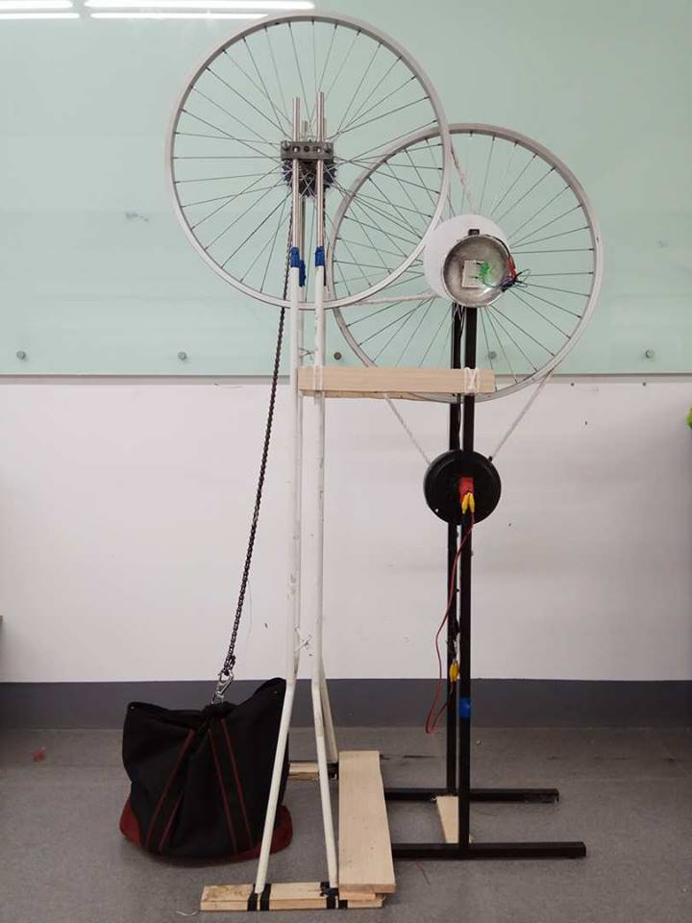
Green powered gravity light
Stella Matutina Girl’s High School
Yi-Hsuan Chen, Yann-Tsyr Tuan, Zi-Yun, Lai

Slide 2
Table of Contents
Introduction
Gravity Light
Discussion
Notes:
5

Slide 3
Introduction
Notes:
2

Slide 4
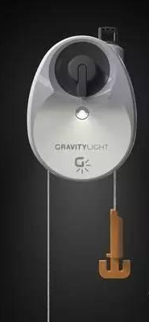
Literature Review—
Ready-made Gravity Light
Gravity light, invented in2012 by Jim Reeves and Martin Reddiford, is a lighting equipment that can shine by Potential Energy.
It provides light without electricity and benefits poor countries.
Notes:
15

Slide 5
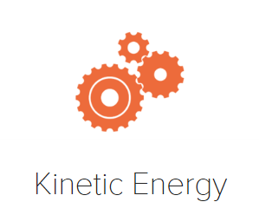
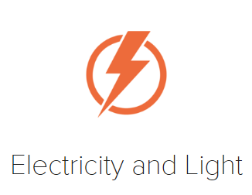
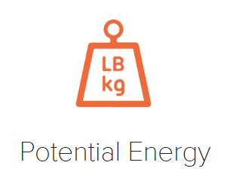
Literature Review—
Ready-made Gravity Light
How does it work?
Notes:
20

Slide 6
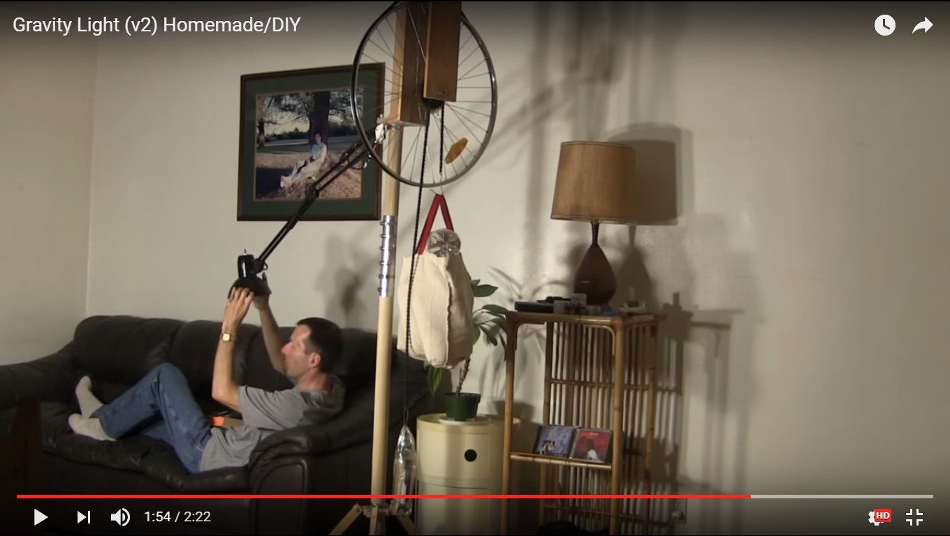
Literature Review—
Home-made Gravity Light
Notes:
8

Slide 7
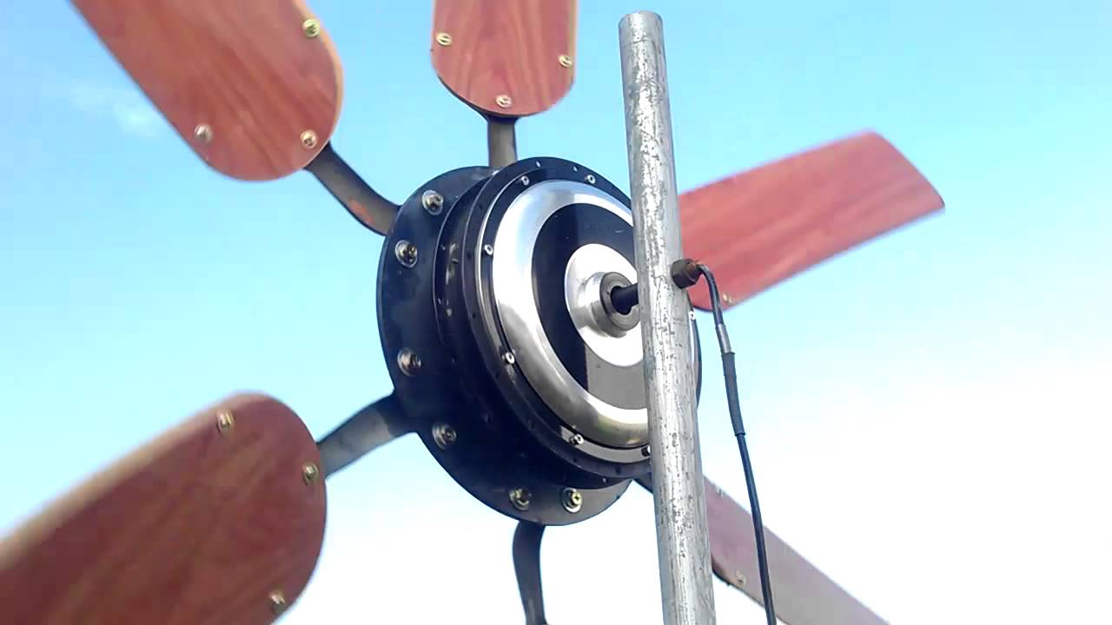
Literature Review—
Celling Fan Wind Turbine
Notes:
8

Slide 8
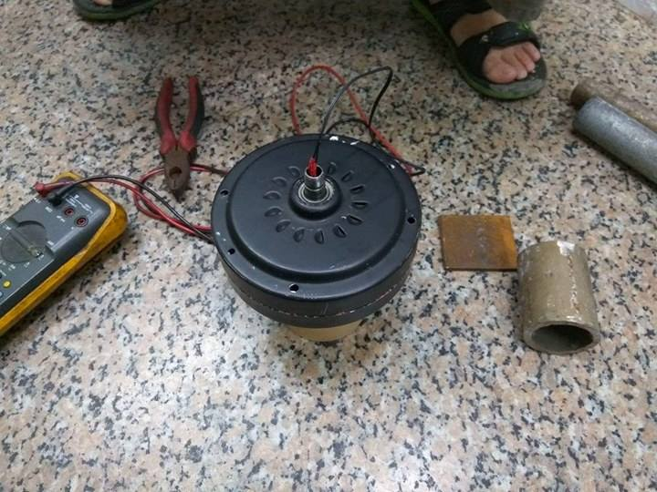
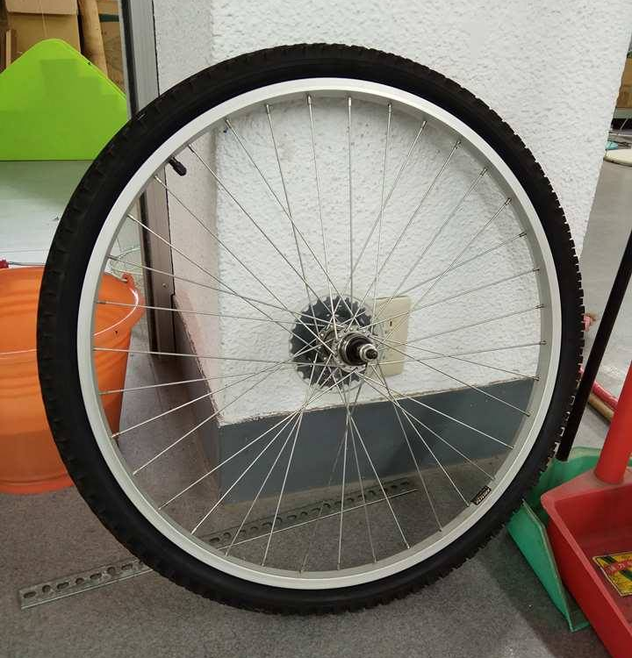
Research Purpose
DIY gravity light with recycled materials.
▲ the motor of a broken
celling fan
▲the wheel of a broken bike
Notes:
10

Slide 9
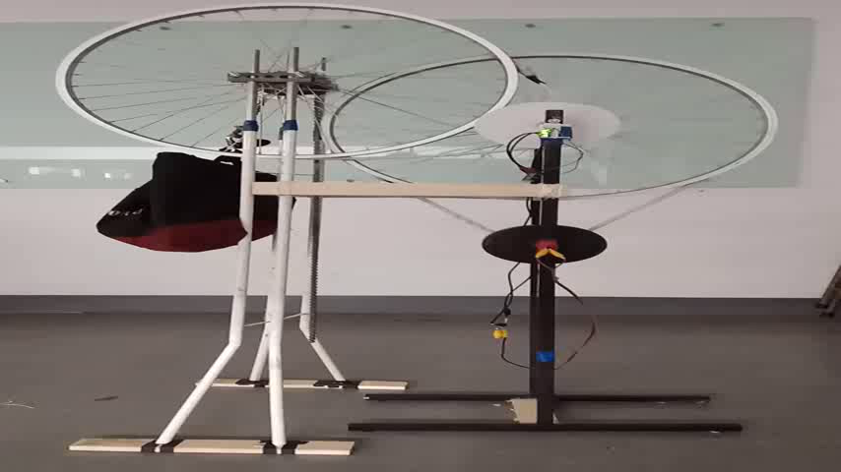
Results—Video

Slide 10
Gravity Light
Notes:
2

Slide 11
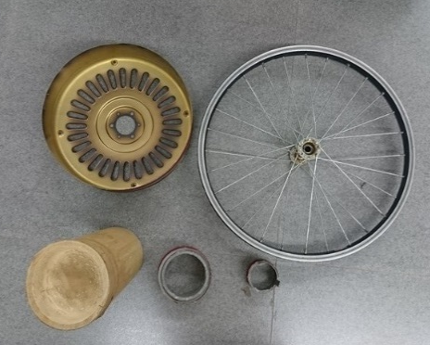
Design
axles
(wheels)
Try different weight from 7~12 kg to test its average voltage and falling time.
Try different wheels and axis of different diameter.
Try hand made generator, modified stand fan motor and modified ceiling fan motor to get the one which has the highest generation.
axis
(bamboo)
LED
weight
generator
(ceiling fan motor)
Notes:
45

Slide 12
Materials—Generator1
LED
CD
Coil
Pipe
Powerful Magnets
▲ hand made generator
Notes:
20

Slide 13
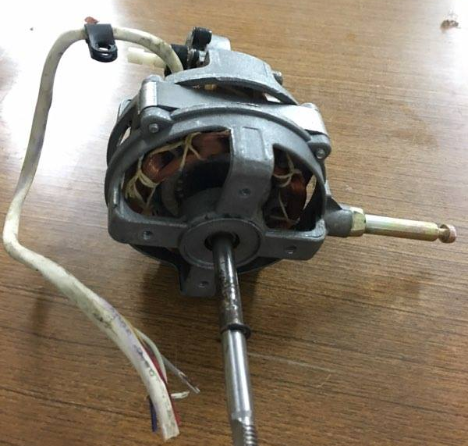
Materials—Generator2
▲ the motor of stand fan
Notes:
12

Slide 14
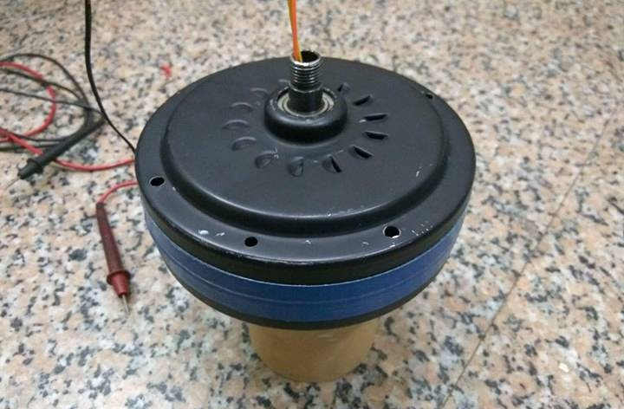
Materials—Generator3
▲ the motor of ceiling fan

Slide 15
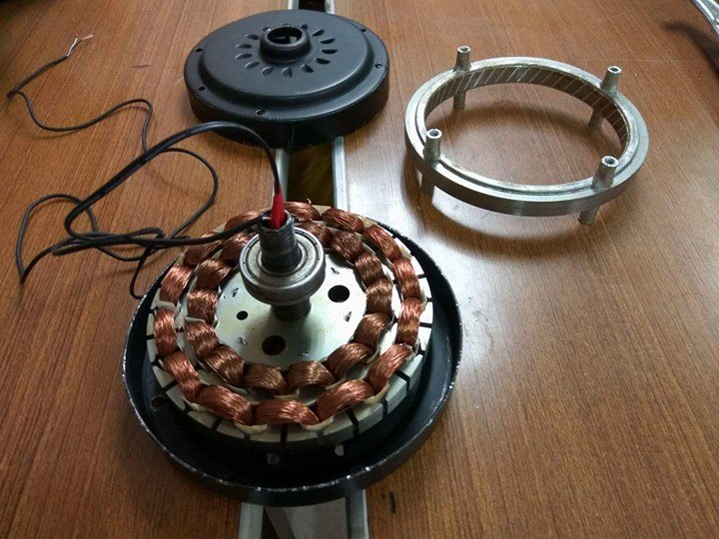
Method—Making Generator3
Take out this

Slide 16
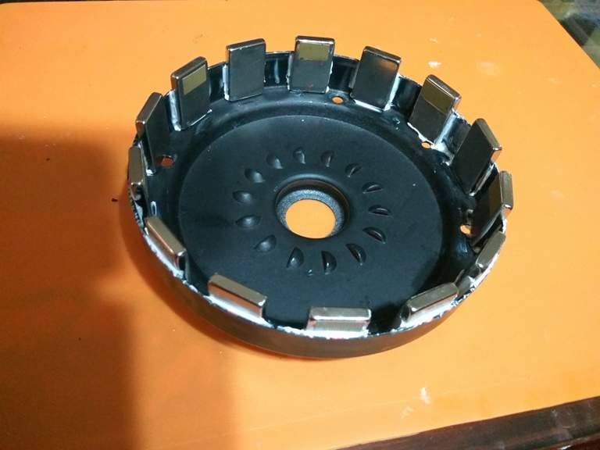
Method—Making Generator3
N
S
N
Stick the magnets
(N-S-N-S)

Slide 17
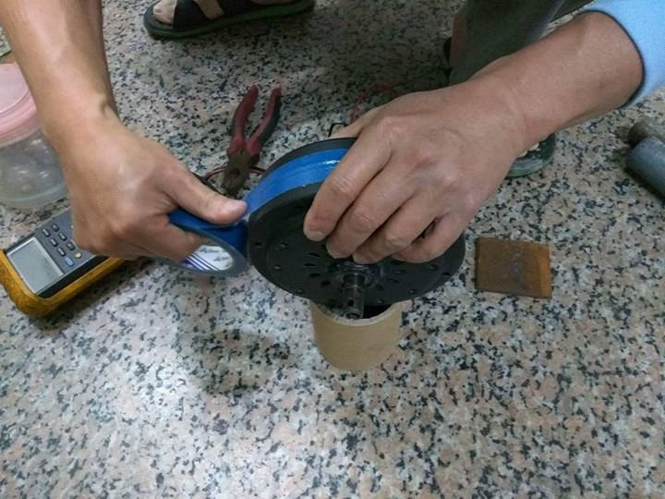
Method—Making Generator3
Seal the outer
Notes:
35

Slide 18
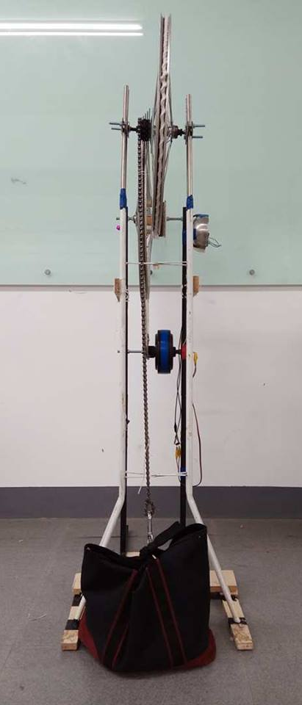
Results
Notes:
10

Slide 19
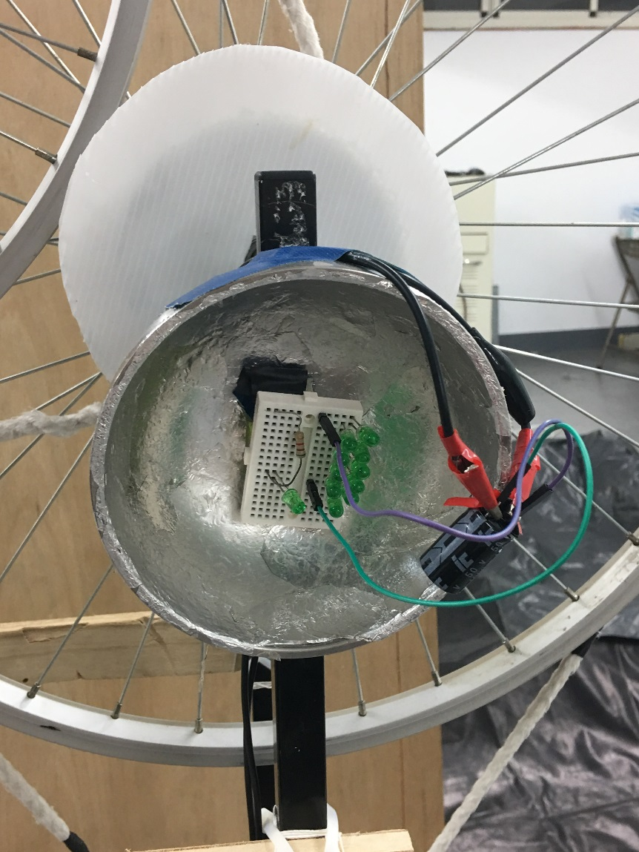
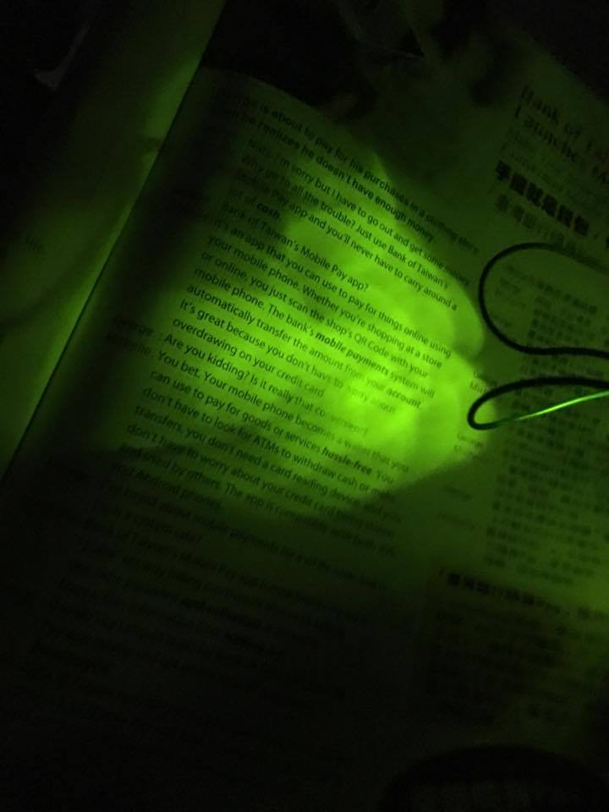
Results
Notes:
10

Slide 20
Data—Weight & Average Voltage
When the weight increases 1 kilogram, the average voltage will increase 5 volts meantime.
Notes:
15

Slide 21
Data—Weight & Falling Time
The falling time decreases as the weight increases.
Notes:
10

Slide 22
Data
—Kinetic Energy Transferring Efficiency
Friction
Heat
Notes:
40

Slide 23
Data
—Kinetic Energy Transferring Efficiency
K E T E
Kinetic Energy Transferring Efficiency
＝ Original Ek- Final Ek
Original Ek
＝ Electric Energy
Original Ek
Original Ek
＝Kinetic of the weight without electrical load
Final Ek
＝Kinetic of the weight with electrical load
Notes:
25
有時間以八公斤為例

Slide 24
Data
—Kinetic Energy Transferring Efficiency
When over 11 kilograms, the kinetic energy transferring efficiency will maintain at 77%.
Notes:
25

Slide 25
Discussion
Notes:
2

Slide 26
Conclusion
Although our gravity light’s generating efficiency cannot compare with the ready-made ones, it is proved that recycled materials can be utilized in real life.
Notes:
12

Slide 27
Conclusion
When under 11 kilograms, the heavier the weight is, the shorter time the LEDs shines, and the more efficient the gravity light is.
When the weight is 8kg, our gravity light is in the best condition. It can fall for 213.9 seconds and produce 12 volts.
Notes:
22
為何用八公斤

Slide 28
Future Expansion
Hang our Gravity Light on the wall to:
shrink its volume
create longer time for the LEDs to illuminate
Notes:
15

Slide 29
Future Expansion
Add battery in the circuit to:
hang heavier weight to improve the generating efficiency
make the LEDs’ brighter.
Notes:
15

Slide 30
Q&A

