Slide 1
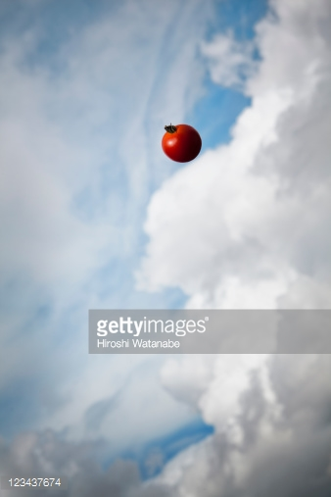
Cloudy with a chance of TOMATOS
By Brendan Lam, Woody Lam,
Grace Lee, Joseph Leung & Samuel Seet

Slide 2

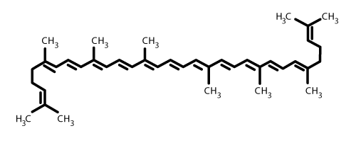
LYCOPENE
Deep/bright red pigment found in tomatoes
A powerful antioxidant
Responsible for biosynthesis of carotenoids (e.g. beta carotene)
Shown to prevent cancer and cardiovascular
diseases, improve eye health,etc.

Slide 3

Objectives
To investigate the difference in lycopene released

Slide 4
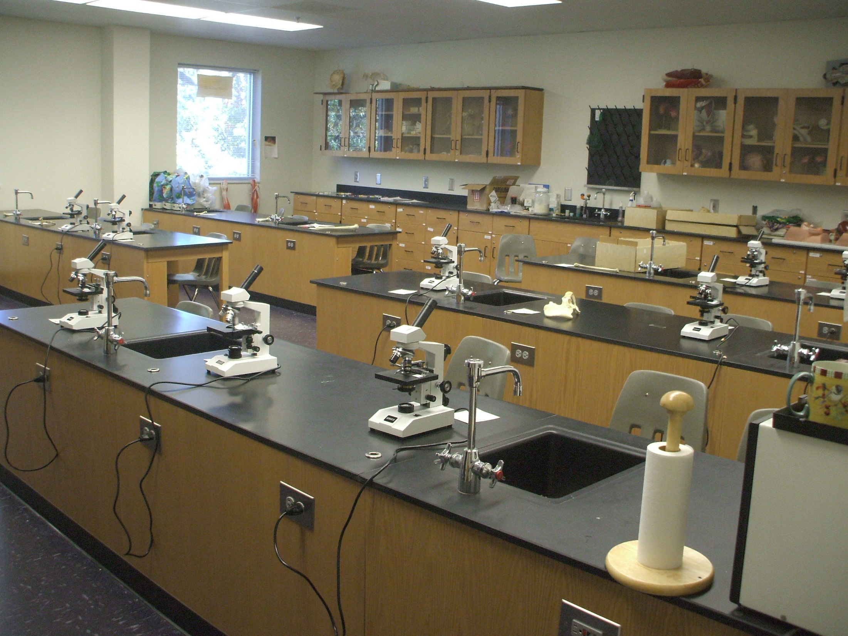
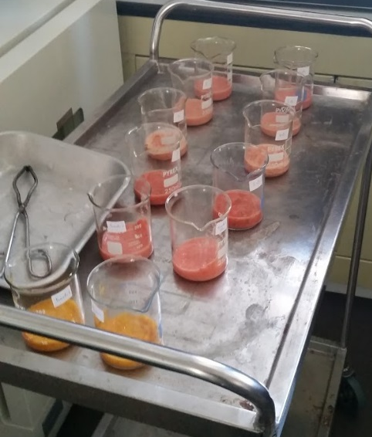
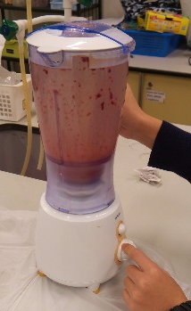
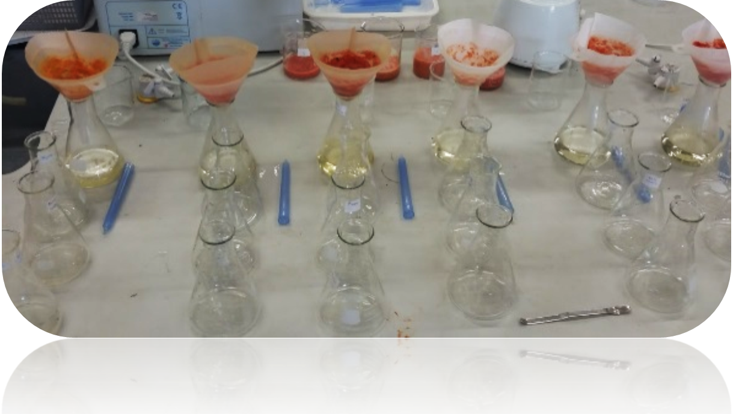
EXPERIMENT PROCEDURES
Treat the mixture
(e.g. bake, cook)
Blend the tomatoes
Conduct titration with iodine solution

Slide 5
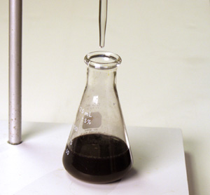
How we tested for LYCOPENE
Tomato samples + Sweet potato powder
Remaining sweet potato powder + vitamin C
Add starch into the mixture
Iodine solution + remaining vitamin C
Iodine solution + starch
More iodine solution = more lycopene

Slide 6
Fair Test!
Constant volume of tomato mash and vitamin C solution
Constant mass of sweet potato powder added
Reliability!
Repeat for 3 times and take average

Slide 7
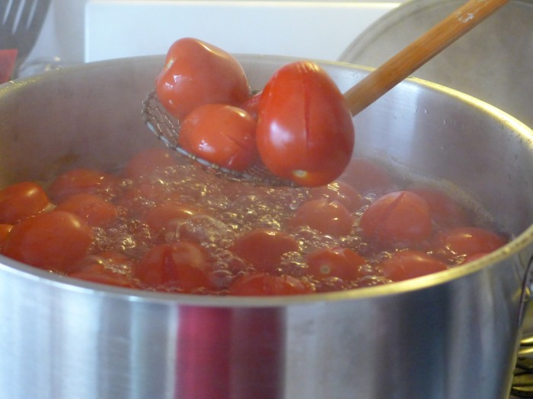
STAGE I Cooking at high temperature
Set-up | Temperature of treatment | Volume titrated (mL) |  |  | Mean volume titrated (mL)
 |  | Trial 1 | Trial 2 | Trial 3
1 | Room temperature | 28.2 | 28.8 | 29.2 | 28.8
2 | 90 °C | 22.1 | 22.0 | 22.7 | 22.2

Slide 8
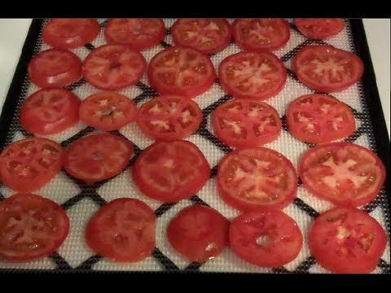
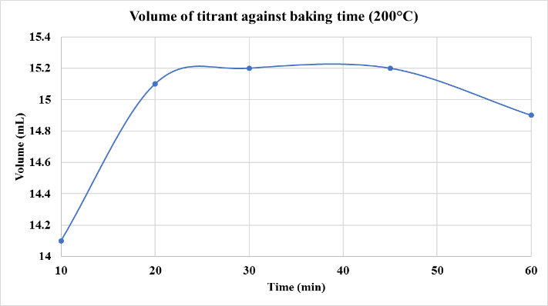
Stage II A Optimal cooking time & baking temperature

Slide 9
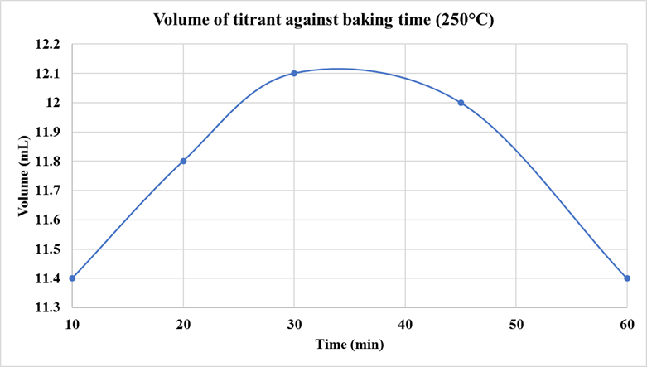
Stage II A Optimal cooking time & baking temperature

Slide 10
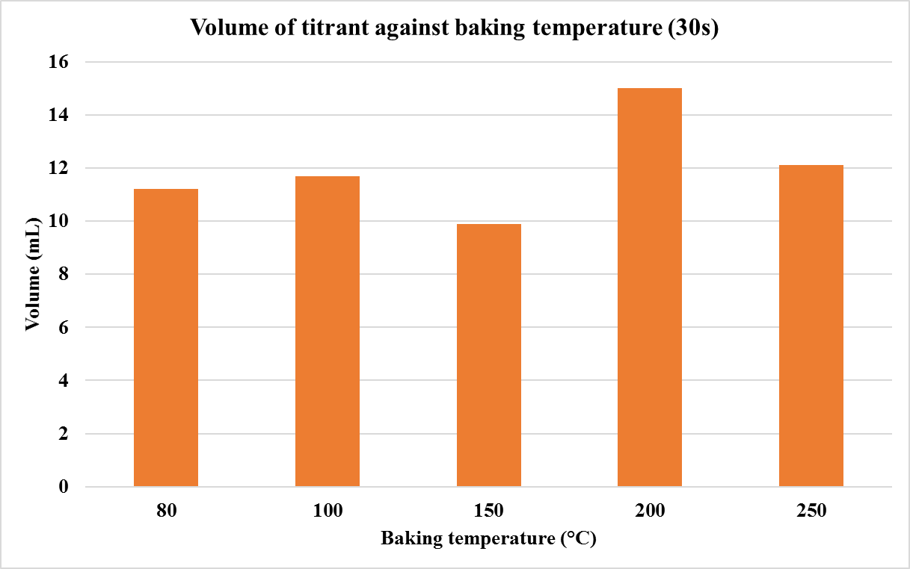

Stage II A Optimal cooking time & baking temperature

Slide 11
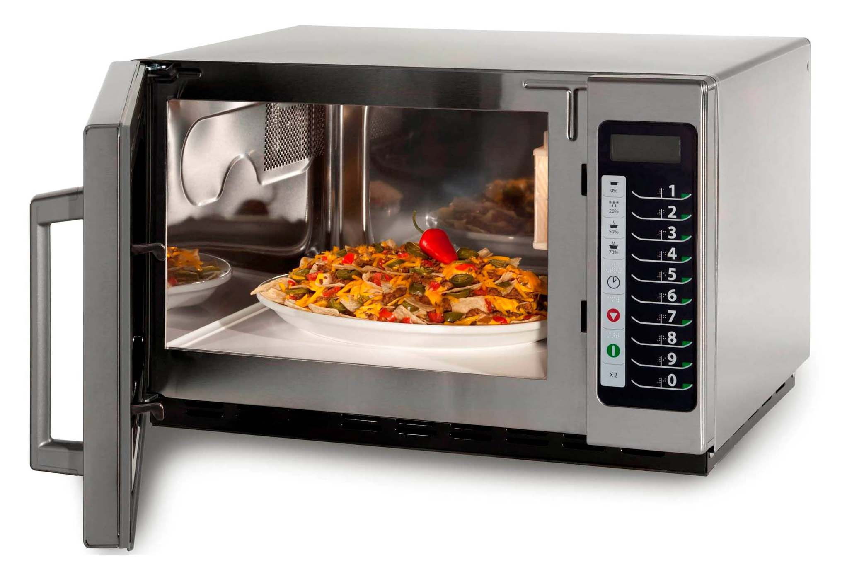
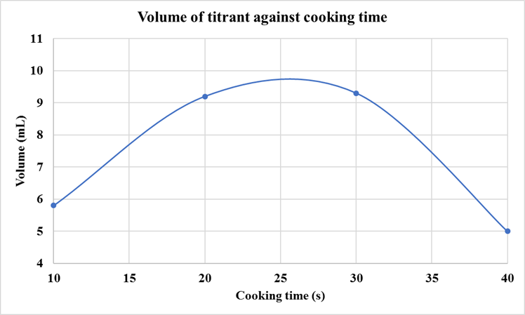
Stage II B optimal cooking time by microwave oven

Slide 12
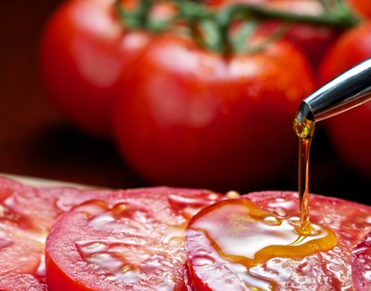
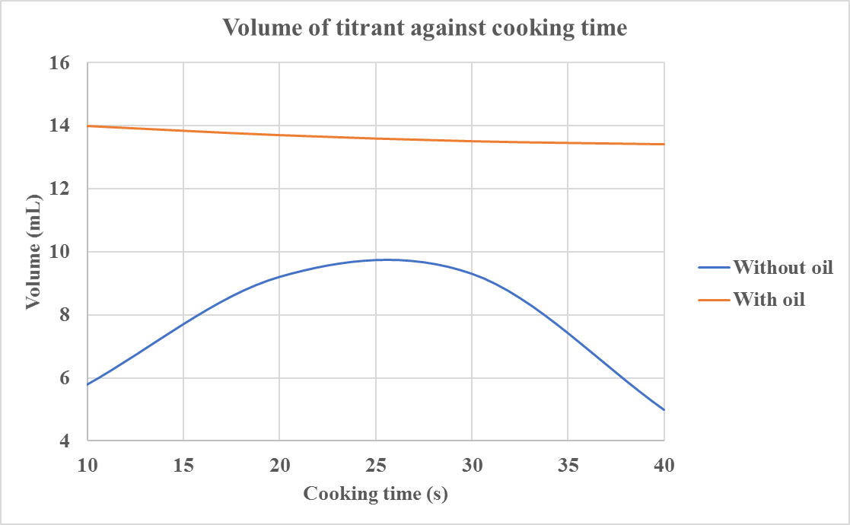
Stage II c addition of olive oil

Slide 13
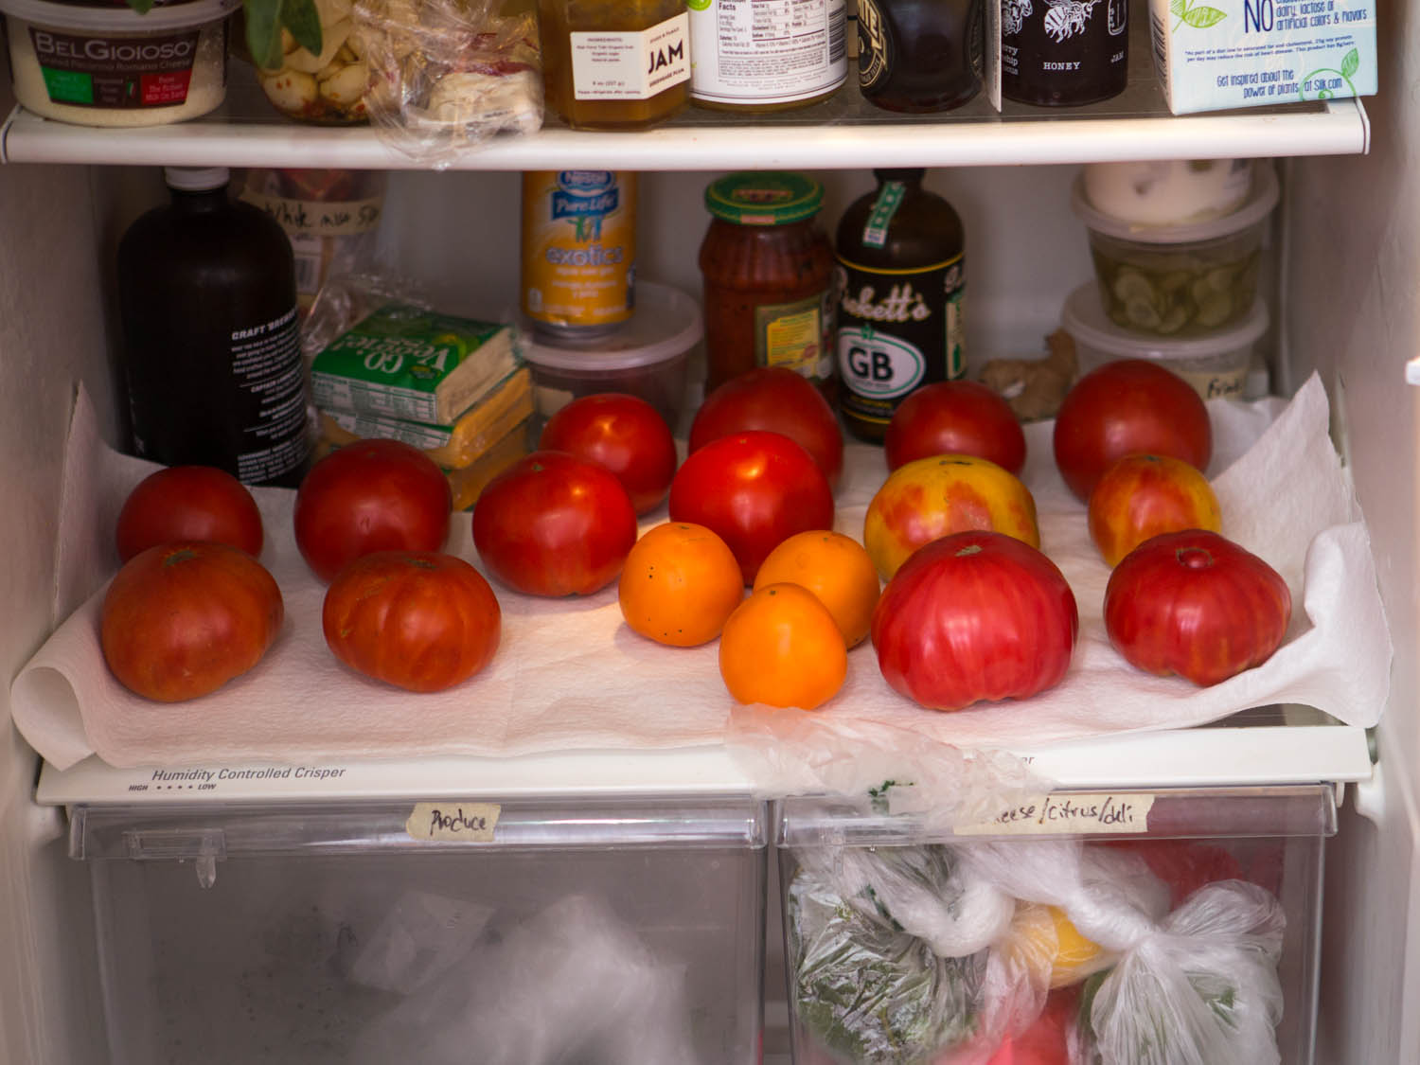
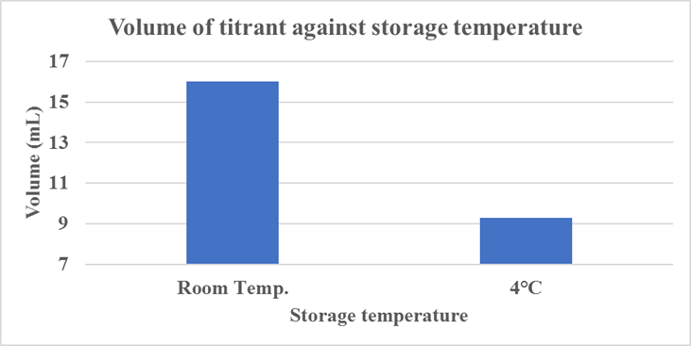
Stage III Storage Temperature

Slide 14
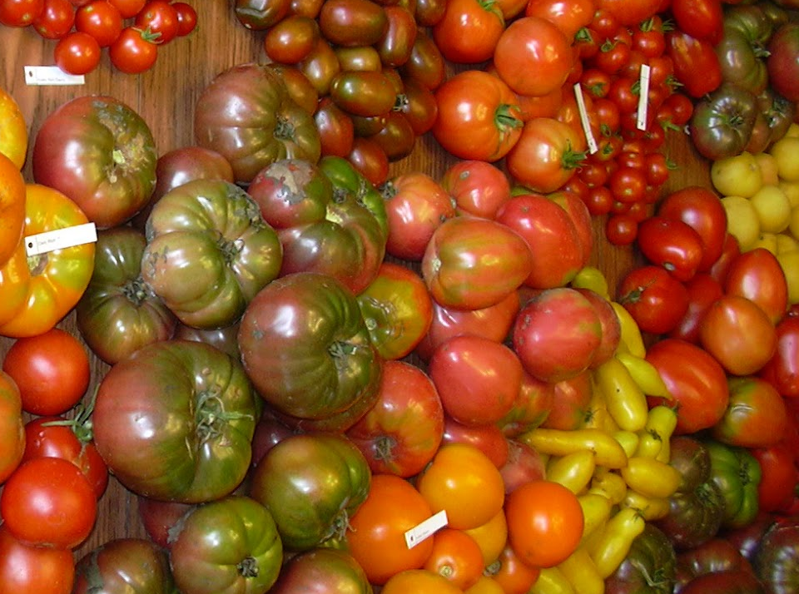
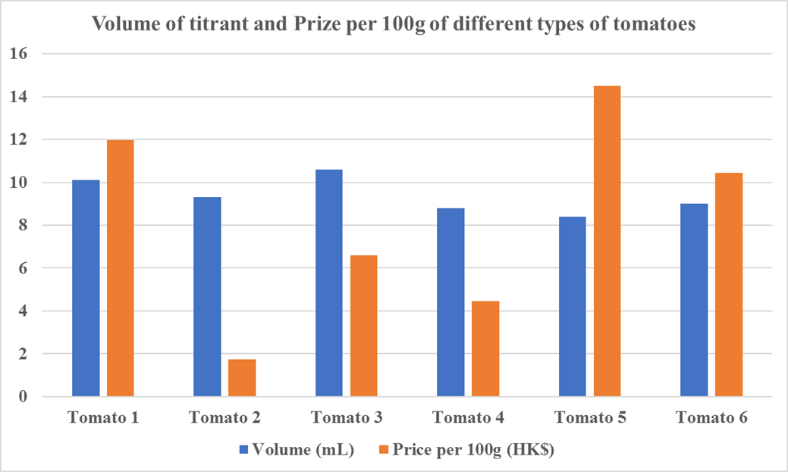


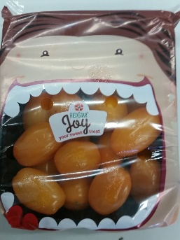
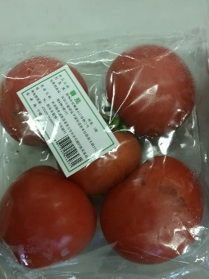
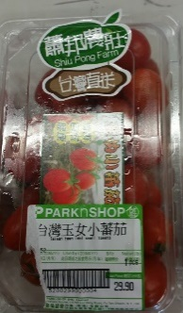
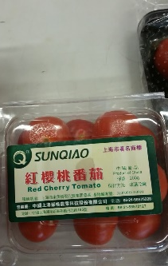
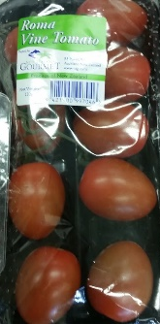
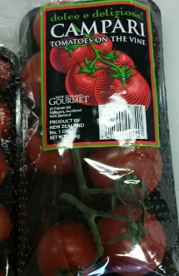
Stage IV different types of tomatoes

Slide 15

Do’s
Store in room condition
Preheat oven to 200°C
Bake for 30 – 40 min
Cook for 30s in microwave oven
Add olive oil
Don’ts
Store in low temperature
Bake for 40 minutes

