Slide 1

The Windy Window
an Economic and environment friendly air-cooler
The Doon School, Dehradun, india
Mahip Agarwal,Aditya Goel,Shathaayu Patil & Shivendra P.Singh

Slide 2
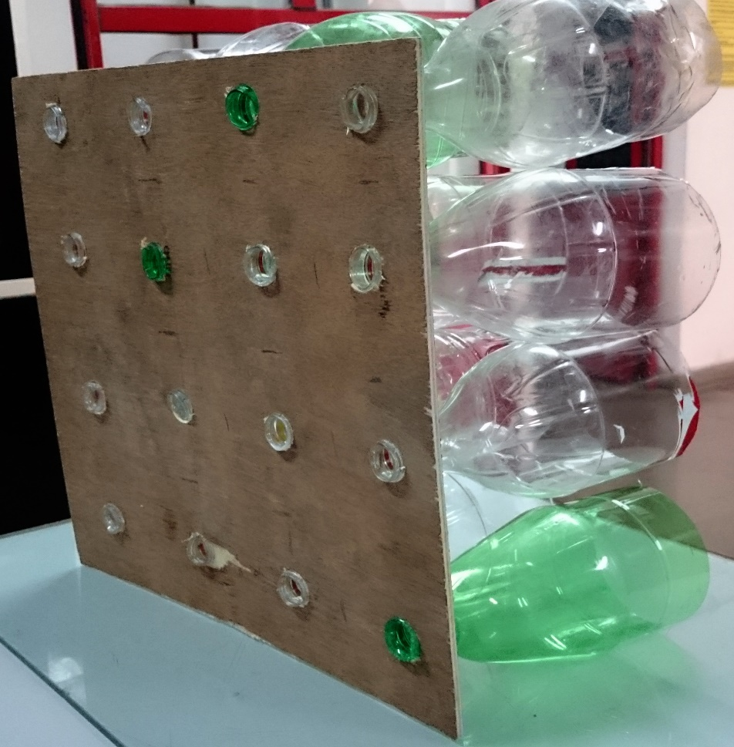
Research Question
Study the factors affecting the cooling produced by the Eco-Cooler.
Points of Elaboration:-
The optimum size of inner and outer diameter of the cone required for effective cooling.
Effectiveness of the cooler with reference to Indian context.

Slide 3
Speed
Hot Air
What ?
When ?
How ?
Compression
Adiabatic expansion causes cooling

Slide 4
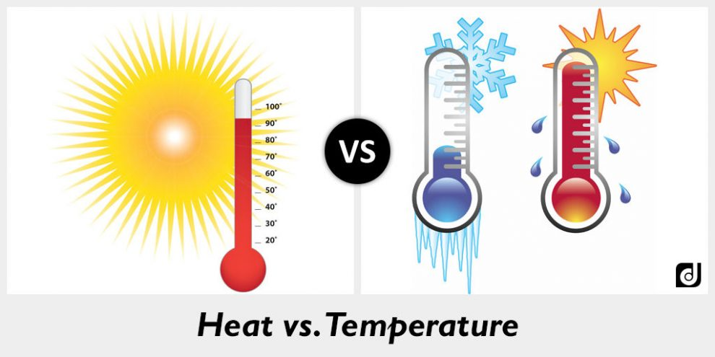


Initial Testing of the Window (Lab Condition)
Tested the temperature difference using one bottle
2-3℃ drop recorded
Note: Wind speed was 3.5 m/s

Slide 5
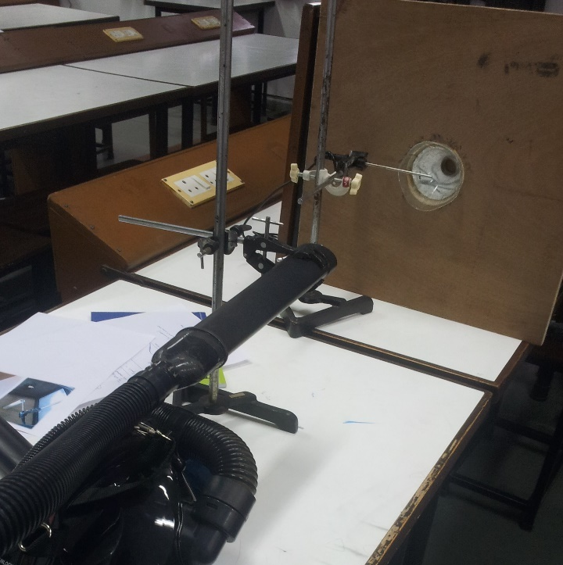
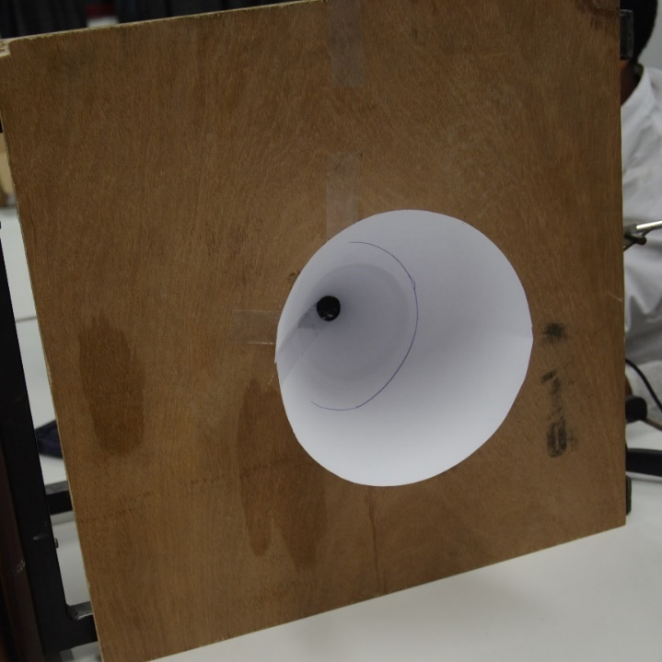
Next Step….
Testing air-flow with a Coca-Cola Bottle.
Testing the air-flow with cones of different inlet and outlet diameters.
Testing air-flow in the case of a normal window.

Slide 6
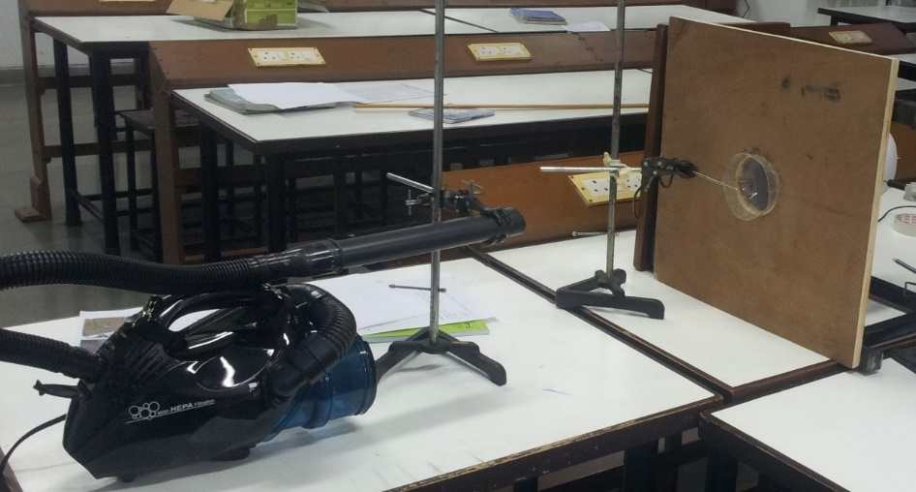
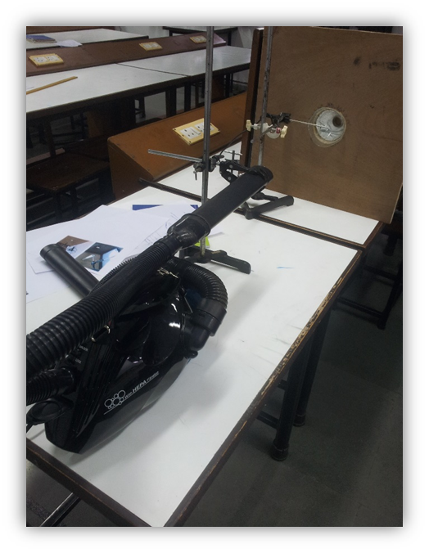
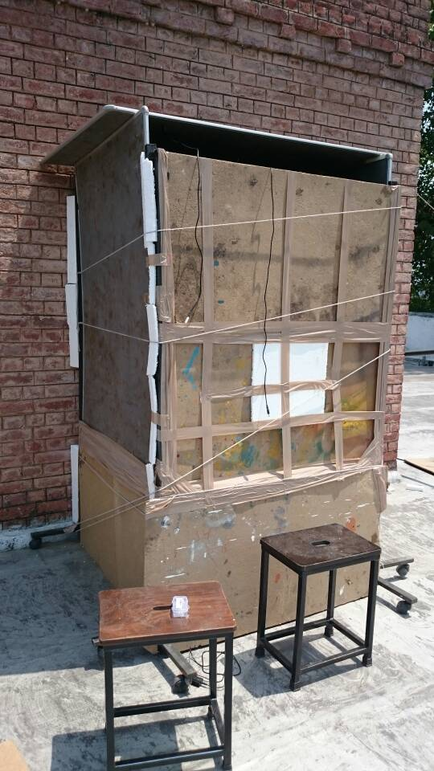
How Did We Conduct The Experiments ?
Vacuum Cleaner to throw air.
Wooden board with hole to attach bottle/cones.
Temperature Probe.
Anemometer to record Wind Speed.
Logger Lite Software to take readings.
Note- The accuracy of the Anemometer was - ± 0.3%
The accuracy of the Thermometer was - ± 0.3%

Slide 7
Data Collection and Analysis
Conclusions
When there is no bottle kept in the middle, speed is relatively low
When there is a tube kept, the speed further decreases
Speed increases with increase in diameter but only up to a certain point
8 cm is considered favourable
Note- Size of Outlet was kept constant at 2.0 cm

Slide 8
Data Collection and Analysis
Conclusions
When the opening is small, air passes through it with negligible speed
As the size (diameter) increases, the speed also increases
After a certain point, the speed becomes constant
2.0 cm is considered favourable
Note- Size of Inlet was kept constant at 8.0 cm

Slide 9

Why this, Why not that ?
Analysis of data obtained on varying inlet diameter
Quantity of air increased > Opening was small > Air possessed less potential energy > Air flow decreased after 8 cm
Analysis of data obtained on varying outlet diameter
Speed was lowered > There was no contraction taking place > No use of the cones

Slide 10
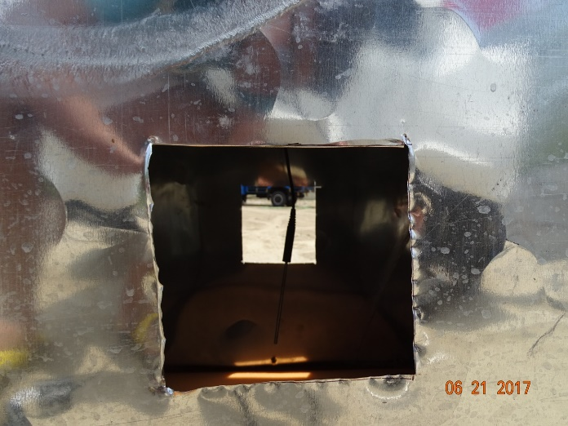
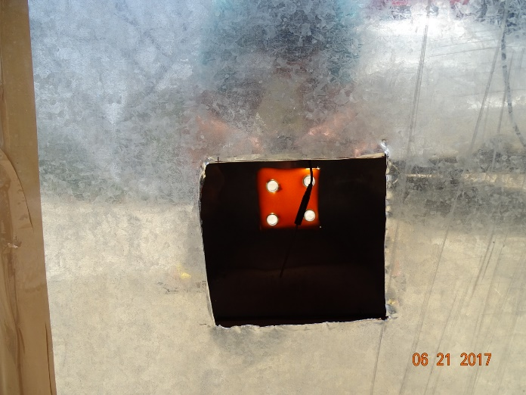
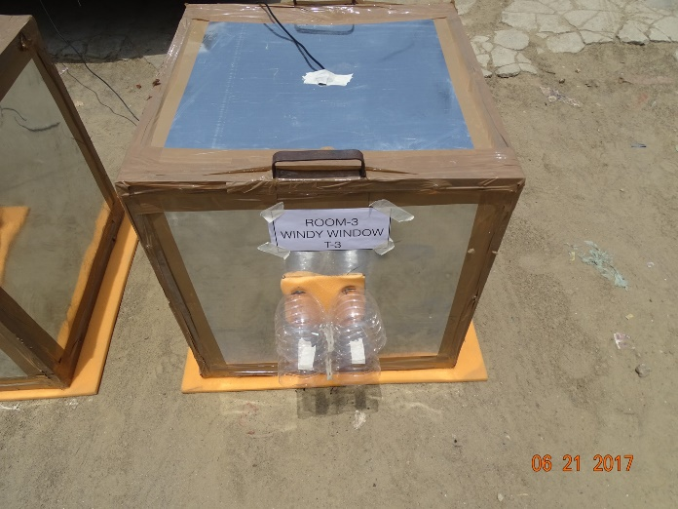
Recording Temperature drop with other design cones. (Future Aim)
Recording Temperature drop with cola bottles.
Recording Temperature drop in case of a normal window.

Slide 11
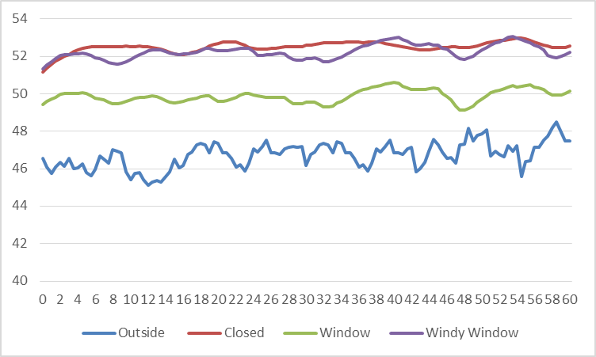
Data Collection and Analysis
Conclusions
When the window is closed, the room gets heated up the most
When the window is open the room is cooler
Windy Window is not lowering the temperature
Temperature (in ℃)
Time (in Minute)

Slide 12
Why was the temperature difference not attained?
Air is moving at a low speed (0.8 m/s), hence it does not have enough energy to pass through the small opening
What can be done now ?
Create low pressure in the room which will create a pull and hence air will enter at an increased speed

Slide 13
Limitations & Errors
2-3 ℃ obtained in the lab but the result was not as desired in the room
Environmental factors (Humidity,wind speed etc.) outside the model room were irregular
Length of the cone was not varied (Future Aim)
Notes:
Readings were not taken on a single day so temperature varied

Slide 14
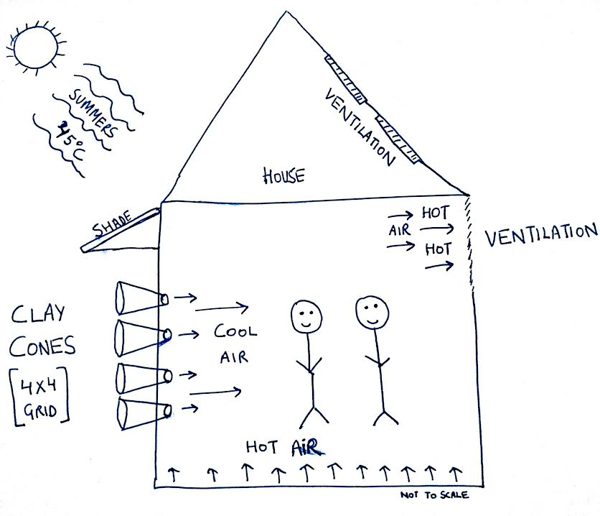
Conclusions/ Future Plans
Works when the wind speed is above 3.5m/s
Can be used in well ventilated houses or locations (flat) with high wind speeds
Future Aims -
Modify it further to reach maximum attainable temperature difference
Make a working and effective model and use wherever needed
Notes:
Many experiments can still be done….we can variate the length…speed of air

Slide 15
Bibliography
https://www.youtube.com/watch?v=i2NWr6bRKWU
http://craig-russell.co.uk/demos/cone_calculator/

Slide 16



Thank You
Grazie
謝謝
谢谢
多謝
धन्यवाद
рақмет сізге

